Slide 1
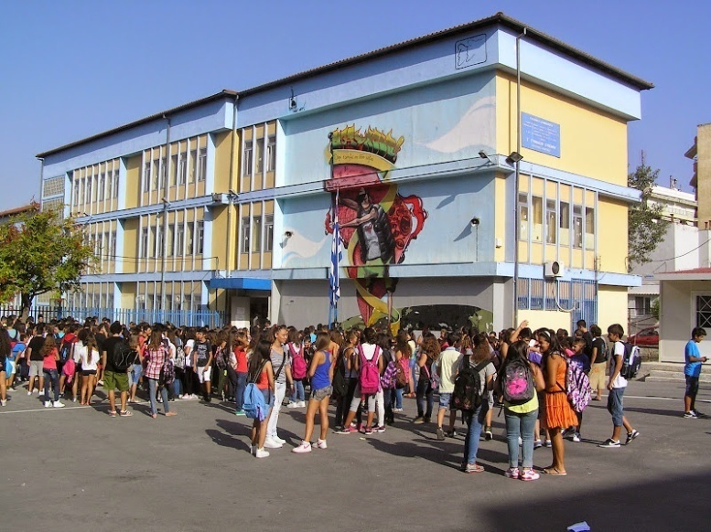
Our School
Information about the 2nd high school of Evosmos
Ioannis Karkaridis

Slide 2
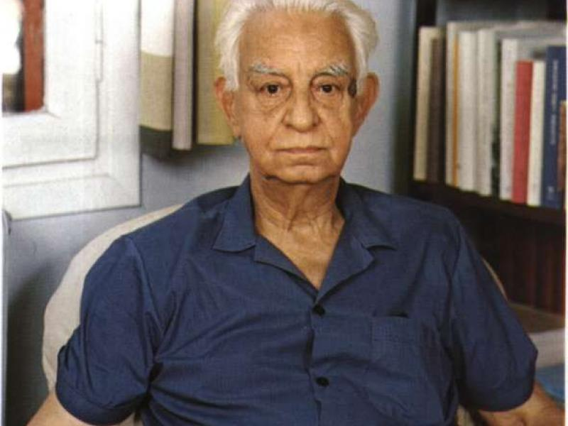
Where it got it’s name from
The second high school of Evosmos Includes the name of famous Greek author and educator Ioannis Karkaridis.
Ioannis studied at many top European Universities and wrote many works in literature with his most famous being co authoring The Iliad and Odyssey (1965) with Nikos Kazantzakis
He was also a renowned reformer of the education system (simplifying the tonal system)

Slide 3
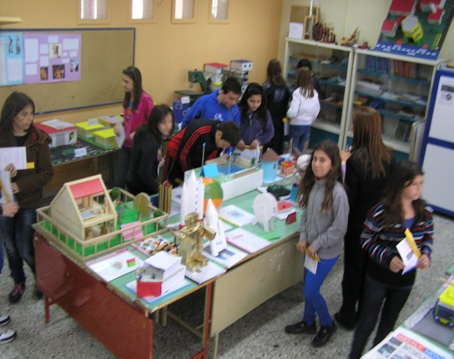
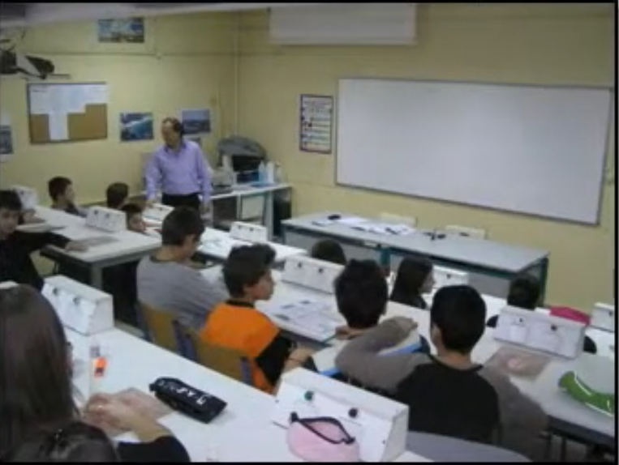
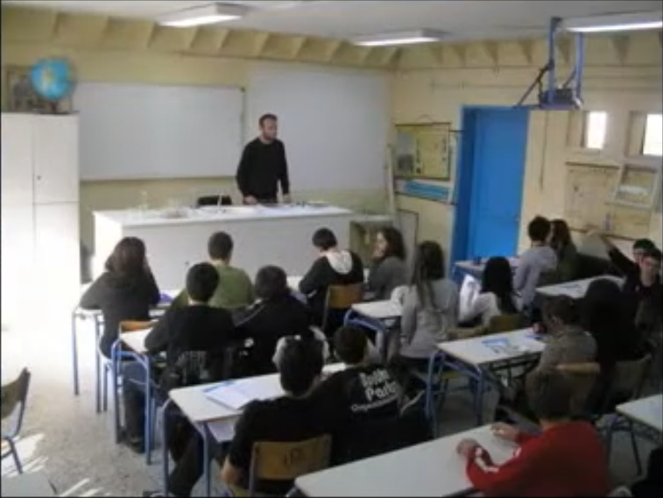
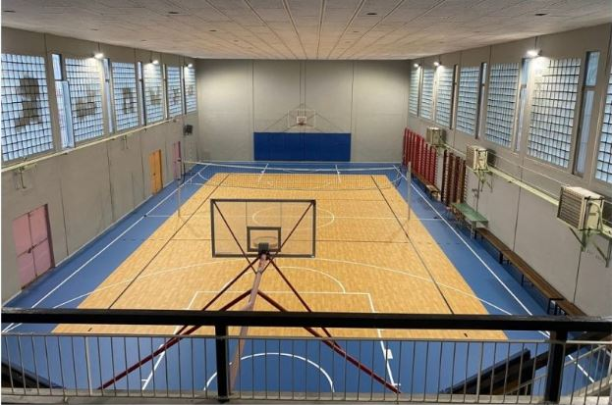
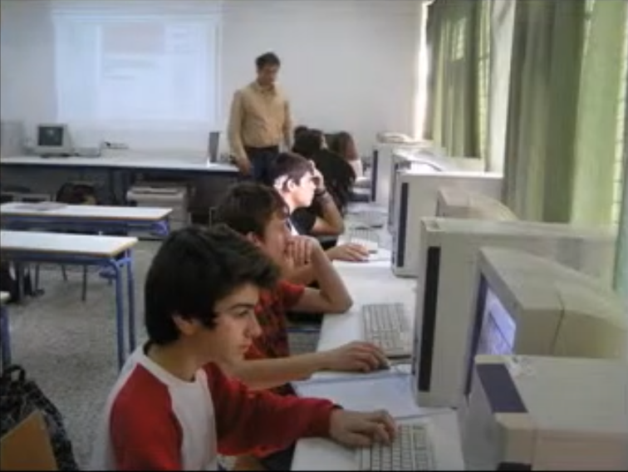
The History And Building Of Our School
Being built in 1979, originally to house an elementary school, it first hosted the families of immigrants of Smyrna.
Since it’s inception it has played a big role in the local area of Evosmos, providing skills and memories to students and teachers alike with programmes and lessons
It’s comprised 4 labs ( Physics, Chemistry, Technology and IT) a recently renovated gym and a yard that’s divided into 4 parts
And around 15 classrooms

Slide 4
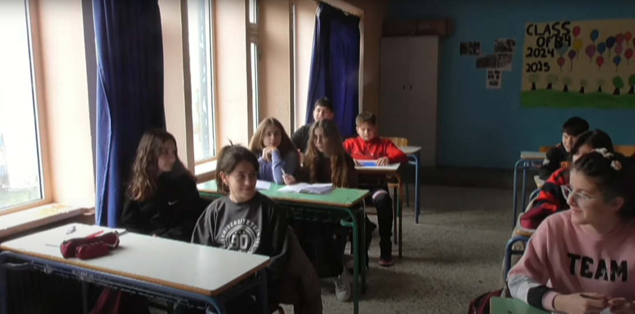
Meet The Students
From the 80s to the 20s our students have done more than just learning and studying
For most of it’s history around 400 have been attending at a time
And they have found creative ways to express themselves in school
Regularly having fun during brakes and showcasing their talents during festivals and competions.
They have also been participating in extracurriculars that have shaped their lives and the school.
Since 2013 we have hosted “Our little circus” where students have excelled in tricks and magic.
We host an online and physical newspaper “the alternatives” (oi enalaktikoi)
We have made many short films about anti bullying, the environment and comedy

Slide 5
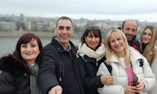
Meet The Teachers
There are no students without an amazing group of teachers guiding them along the way.
Every year around 40-50 teachers are staffed and take care of educating students on the curriculum but also teach life skills and organize competitions and programmes for them.
Every day the clock in putting in their maximum effort with the recourses the have.
They take time out of their out of school hours to grade assignments, prepare next day’s lesson and most importantly of all plan different activities for in or after class

Slide 6
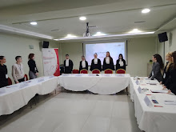
Programmes Attended
Throughout the years the second high school of Evosmos has been represented at programmes all over Europe.
In Poland, Germany, Austria, Turkey, Spain and most importantly Greece, Italy and Croatia.
Our school has been attending robotics competitions since 2010
Going to debate, music technology programmes
Attending European programmes like Erasmus in Vienna, Berlin, Venice and more
It has a quite well travelled history
But it has also been nominated for some of them
Ever since the 1980s our school has been awarded at competitions regarding theatric performances, writing, photography, web design and most notably cinematography, circus performances and newspaper writing.

Slide 7
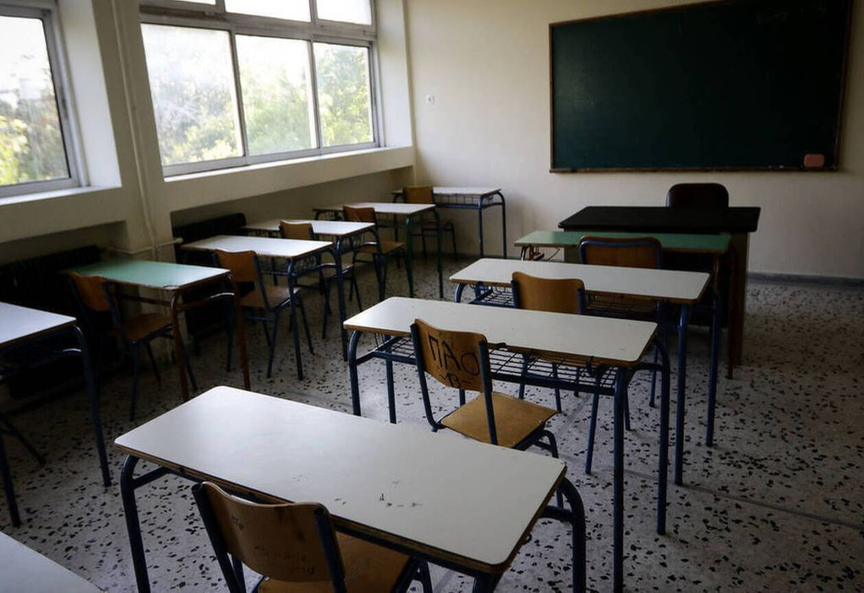
A Bit About Greek Education
In the Greek educational system you can find many familiar elements and some things that aren’t found in any other country’s system.
Our school is in the second level, after elementary, and is comprised of 3 years.
School lasts roughly 7 hours with every class being 45 minutes long and breaks every hour lasting 10 minutes.
While a lot of emphasis is put on mathematics, biology, physics and foreign languages, with English and either French or German
Subject that hold dear to our culture such as modern and ancient Greek as well as our nations literature and history are all extensively taught as core subjects
Included in the mandatory exams required to pass a grade, in middle and highscool.

Slide 8
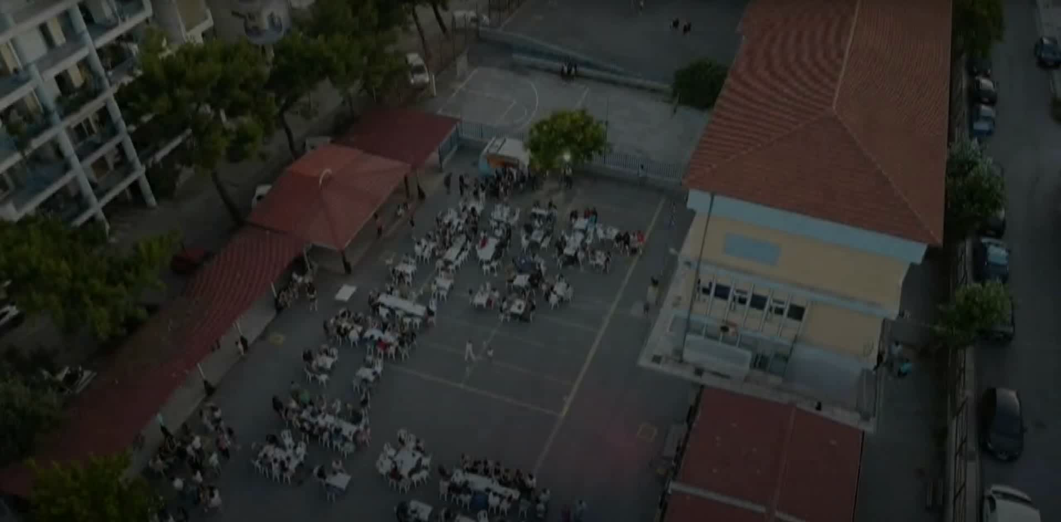
A sky view of our school

