Slide 1
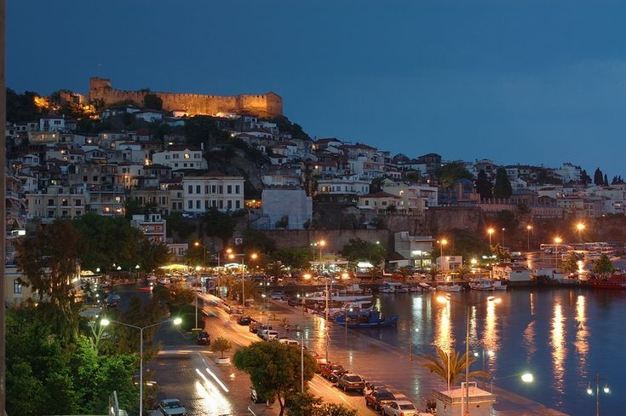
KAVALA
Made by Elena Baltzoglou...

Slide 2
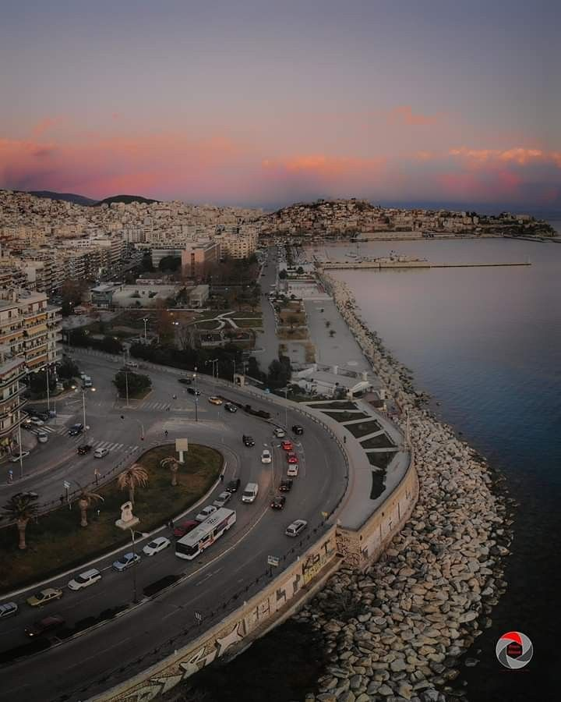
Kavala is a city in northern Greece, the principal seaport of eastern Macedonia and the capital of Kavala regional unit. Kavala is an important economic centre of Northern Greece, a center of commerce, tourism, fishing and oil-related activities and formerly a thriving trade in tobacco.
.
Historically the city is known by several names. In antiquity the name of the city was Neapolis ('new city‘). In the Early Middle Ages it was renamed to Christo(u)polis ('city of Christ') and from the 16th century and on to Kavala

Slide 3
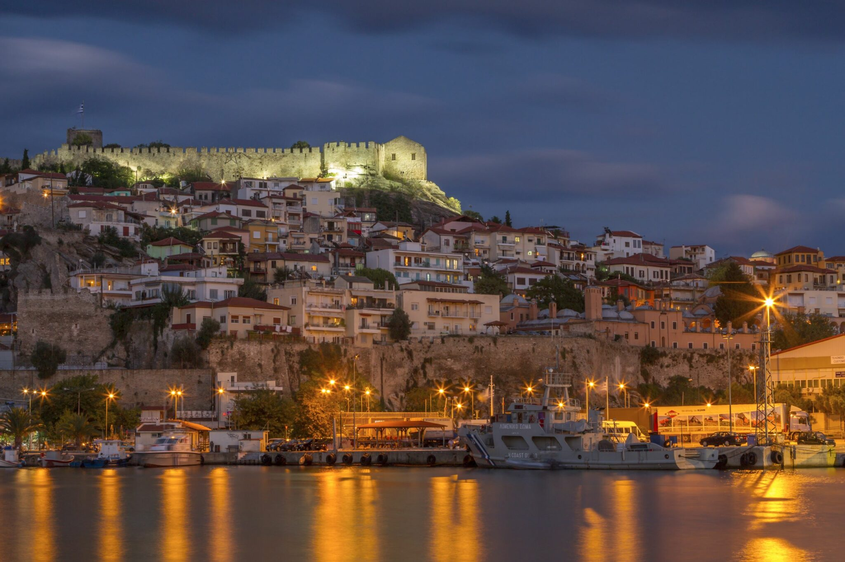
History of Kavala.
Kavala is a beautiful coastal city in northern Greece with a rich history. It has been an important port since ancient times, connecting Greece with Asia and Europe. In ancient times, Kavala was found by Greek settlers from the island of Thasos in the 7th century BC. It was an important trading center and later became part of the Macedonian Kingdom under King Philip II, the father of Alexander the Great. In the Roman and Byzantine periods, basically in 42 BC,. the famous Battle of Philippi took place near Kavala, where the armies of Brutus and Cassius (who killed Julius Caesar) fought against Mark Antony and Octavian (who later became Emperor Augustus). During the Byzantine era, Kavala became a strong fortress and an important Christian center. Apostle Paul is believed to have first arrived in Greece through Kavala while spreading Christianity. During the Ottoman Rule (15th–19th Century), the Ottomans conquered Kavala in 1387, and the city grew under their rule. Many important buildings, like the Kamares Aqueduct (which still stands today), were built during this time.

Slide 4
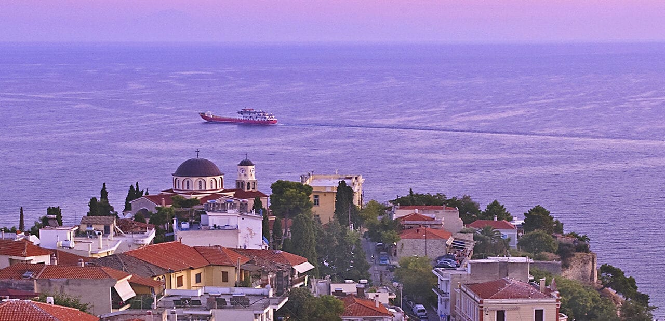
In the 19th century, Kavala became famous for its tobacco trade, bringing wealth to the city. Greece regained control of Kavala from the Ottomans in 1913 after the Balkan Wars. During World War II, Kavala was occupied by Nazi Germany and Bulgaria. After the war, it became a peaceful and prosperous city.
Kavala is now a lively city with beautiful beaches, historic sites, and a busy port. It attracts tourists from all over the world who come to see its castles, old aqueduct, and enjoy the seaside views.

Slide 5
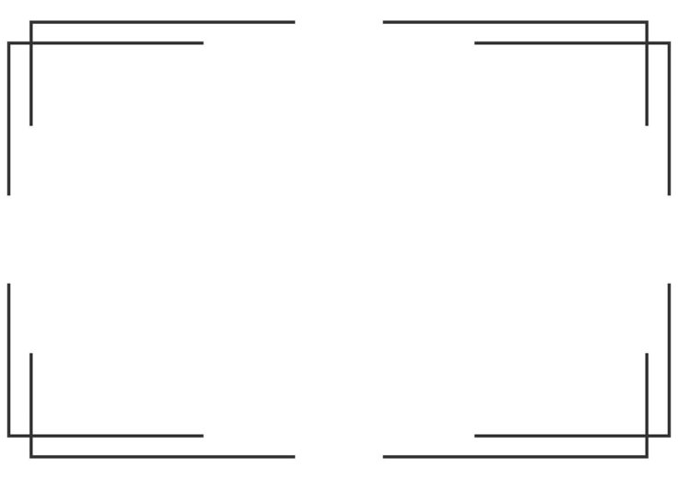
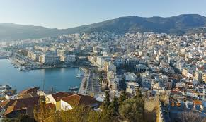
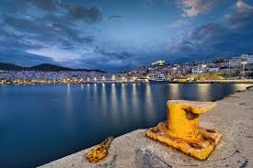
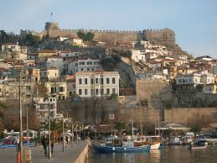
Ports.
OLK SA manages four ports in the Kavala area: the Central Port "Apostolos Pavlos," the Commercial Port "Philip II" in Nea Karvali, the Port of Eleftheres, and the Port of Keramoti.
Each port has a different role, but they all work towards the same goal—to make Kavala an important sea transport hub, especially for the Eastern Balkans.

Slide 6
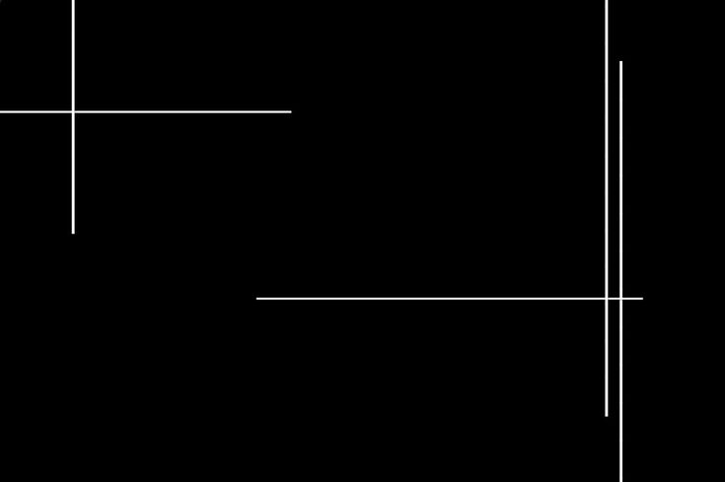
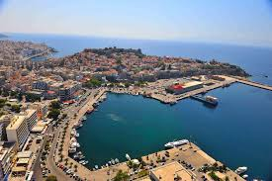
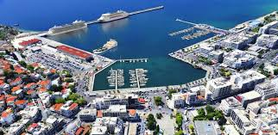
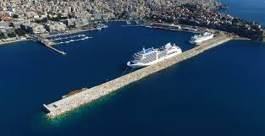
Central Port "Apostolos Pavlos"
"Apostolos Pavlos" is surrounded by the city of Kavala. Until 2002, it was the main hub for sea transport in the region.
In October 2002, cargo operations moved to the "Philip II" port, and now the central port mainly serves passenger ferries (to and from Thassos, as well as regular routes to Lemnos, Lesvos, Chios, and Samos). It also hosts fishing boats, sailing activities, cruise ships, and leisure boats.
The port has 1,950 meters of dock space, with water depths ranging from 4 to 10 meters.

Slide 7
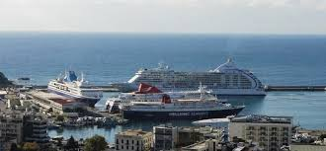
History of the Port "Apostolos Pavlos“.
The Apostolos Pavlos Port has been important to Kavala for many years. It is a natural harbor that has helped connect Greece, the Aegean Islands, and the Balkans through trade and travel.
In ancient times, when Kavala was called Neapolis, the port was used for trade and fishing. It was an important stop for ships traveling between Greece and Asia. During the Byzantine era, the port remained busy, helping ships move between Constantinople and the rest of the Mediterranean.
When the Ottomans ruled Kavala, the port became even more important. It was used for trade, fishing, and shipbuilding. Kavala also became famous for tobacco exports, and many ships left from the port to take tobacco to Europe and the Middle East.

Slide 8
In the early 1900s, the port was improved to handle more passengers and cargo. It became a key link between Northern Greece and the Aegean Islands. For many years, it was the main port for both people and goods.
However, in October 2002, all cargo transport moved to the new Philip II Port in Nea Karvali. This made it easier to handle trade, and Apostolos Pavlos became a passenger-only port. Since then, it has been used for ferries, fishing boats, cruise ships, and sailing.

Slide 9
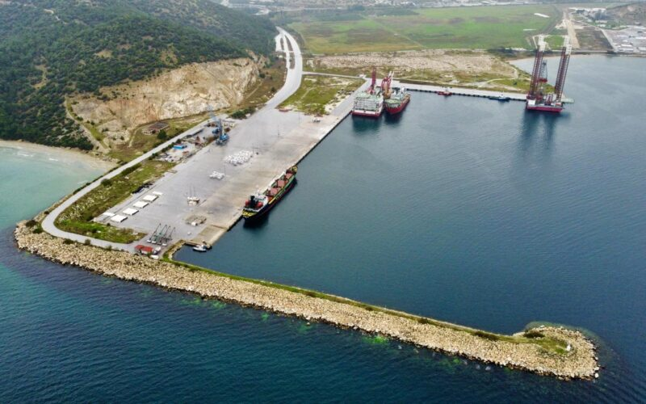
the Commercial Port "Philip II" in Nea Karvali.
The Philip II Port in Nea Karvali is one of the most important ports for cargo handling in northern Greece. It is specifically built to handle large amounts of goods, including things like containers, bulk items (like grains or coal), and fuel.
The port has a modern setup with large docks and warehouses, where goods can be stored and easily loaded or unloaded from ships. This helps businesses move goods quickly and efficiently.
Since it is not used for passenger ferries, the port is mainly focused on helping industry and trade. It plays a big role in the economy of Kavala and the Northern Aegean area, as goods brought here are distributed to many places in
The port is also well-connected to the road network, so it's easy to move goods from the port to other places by truck. This makes it an important part of local and international trade. Greece and beyond.

Slide 10
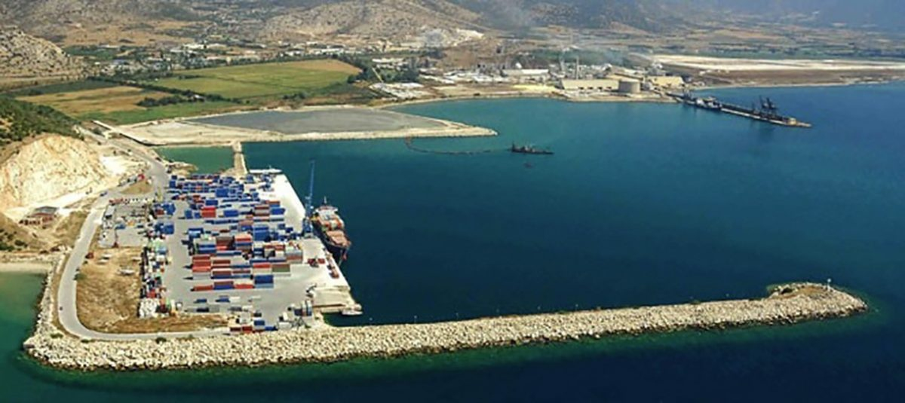
History of the Commercial Port "Philip II" in Nea Karvali.
The Philip II Port in Nea Karvali was built to handle the increased demand for cargo transport in the area. Before the port was built, Kavala's central port (Apostolos Pavlos) handled both passenger and cargo ships. However, as the demand for trade and shipping grew, the need for a larger, specialized port became clear.
In 2002, the Apostolos Pavlos Port became dedicated to passenger ferries only. To replace it for cargo transport, the Philip II Port was developed in Nea Karvali. The port was named after Philip II, the father of Alexander the Great, honoring the region's historical connection to his kingdom.

Slide 11
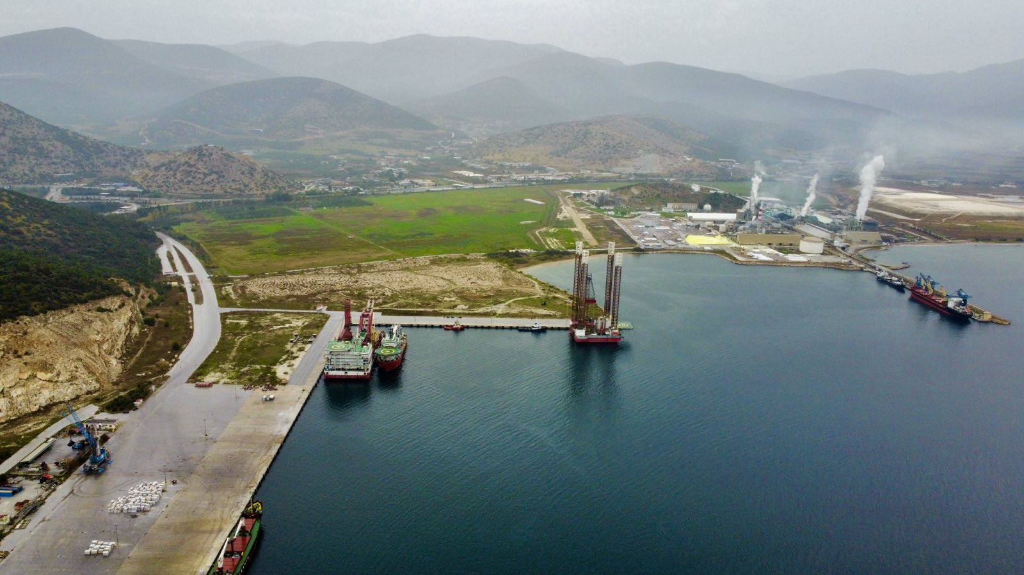
Since its creation, the port has grown and modernized. It has become a key point for trade and industrial activities, supporting businesses in the area by bringing in goods and sending products out. Over time, it has handled a variety of goods, including containers, bulk materials, and fuel.
Today, the port is an important part of the economy of Kavala and the Northern Aegean region. It continues to grow and improve, with plans to expand its capacity to handle more cargo in the future.

Slide 12
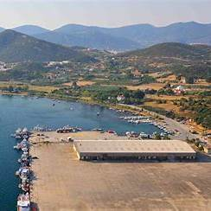
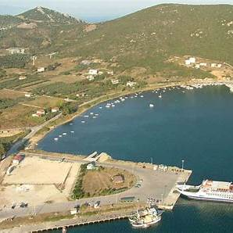
The Port of Eleftheres.
The Port of Eleftheres is located approximately 17 kilometers west of Kavala, Greece, along the northeastern coast of the country. This port serves multiple functions, including the transport of bulk cargo, accommodating the fishing fleet as a reserve area, and supporting tourism by welcoming cruise ships and pleasure yachts. The harbor has a depth of up to 10 meters, facilitating various maritime activities.
Situated near the town of Nea Peramos, Eleftheres also offers access to local beaches, some of which have been awarded the Blue Flag for their excellent water quality. During the summer months, the port operates routes to and from the island of Thassos, enhancing its role in regional tourism.

Slide 13
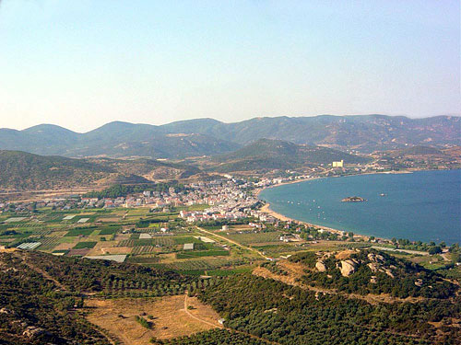
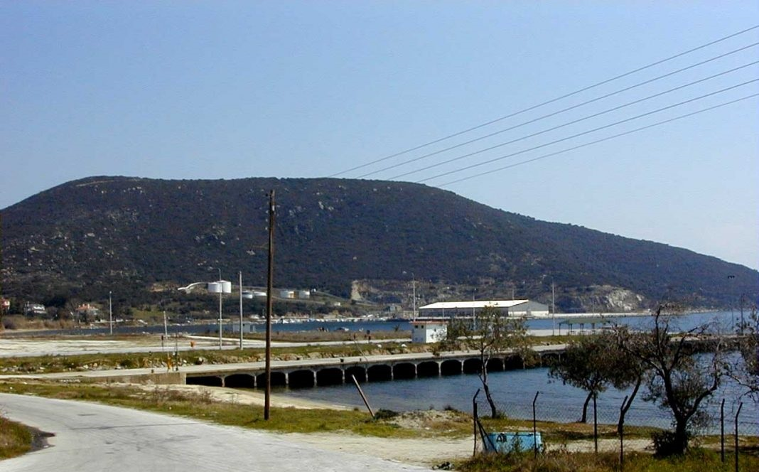
History of The Port of Eleftheres.
The Port of Eleftheres is an old port in Greece, near a town called Nea Peramos and the city of Kavala. A long time ago, people used this place to fish, travel, and trade goods.
In the 2000s, the port started welcoming tourists and small cruise ships.
Today, the Port of Eleftheres is used for fishing, tourism, and cargo transport.
It is also close to beautiful beaches and the island of Thassos, making it a great place to visit!
Thousands of years ago, this area was part of Ancient Greece. Ships came here to buy and sell things like olive oil, wine, and fish. The sea was very important for travel and trade.
For many years, Greece was controlled by the Ottoman Empire. The port was still used for fishing and trade, but it was not as busy as bigger ports like Thessaloniki or Kavala.
In the 1900s, after Greece became free, the port became more active again. Fishermen used it, and boats carried goods like fruits and vegetables

Slide 14
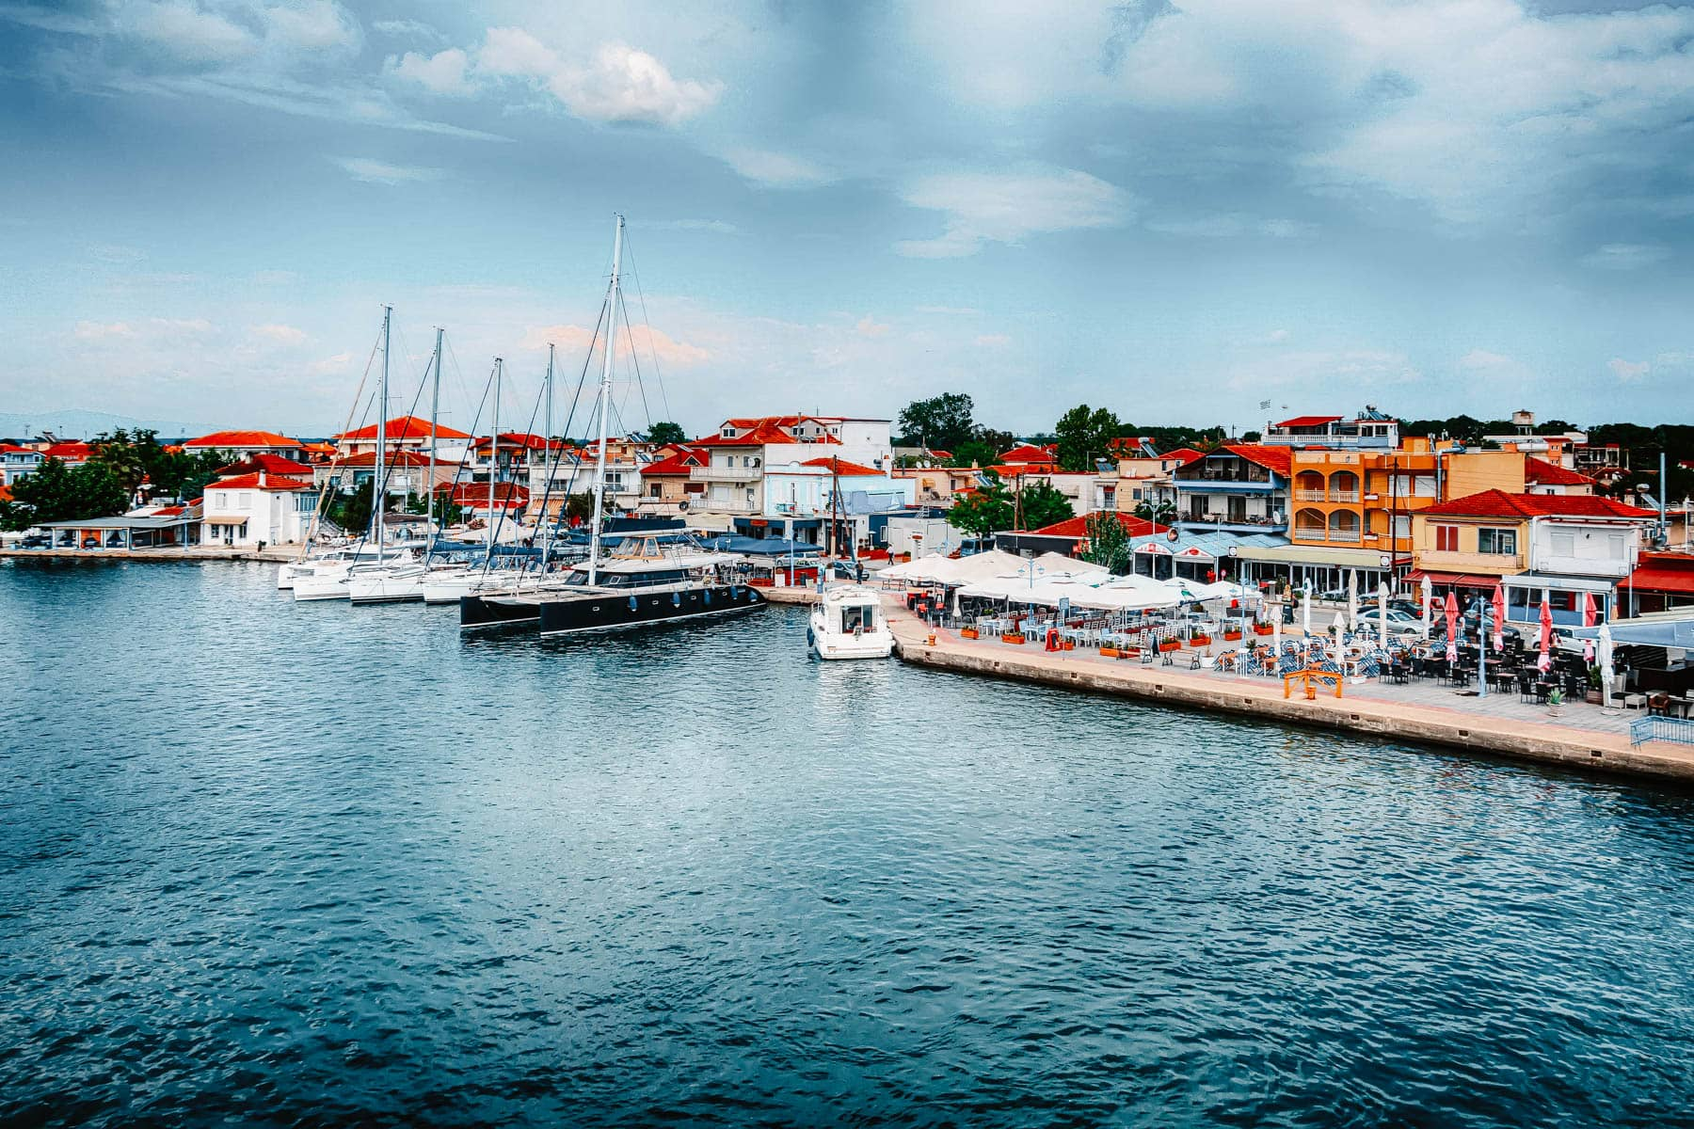
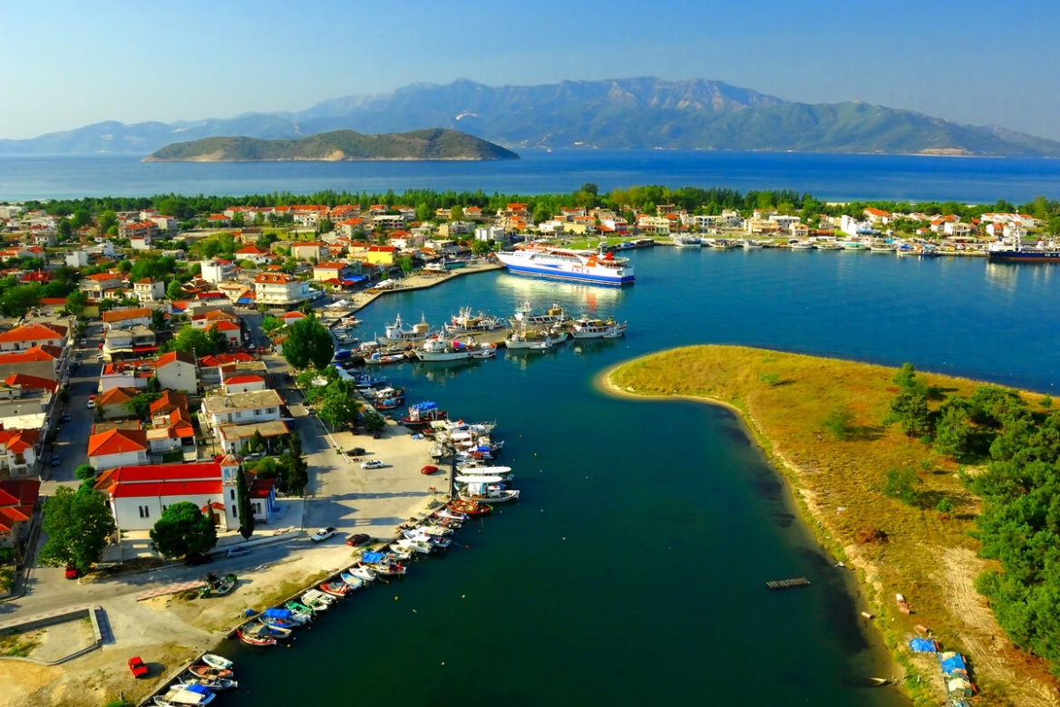
The Port of Keramoti.
The Port of Keramoti is a small but busy port in northern Greece. It is the main ferry connection to the island of Thassos, with ferries running all day. The ferry ride is short, taking only 35 minutes, making it the fastest way to reach the island.
Visitors can enjoy relaxing by the sea, eating fresh seafood, or exploring the nearby nature parks. The area is known for its wildlife and peaceful atmosphere. With its mix of travel, fishing, and tourism, the Port of Keramoti is a lively and welcoming place for visitors.
The port is also used by fishermen, who bring in fresh fish, and by cargo ships transporting goods. Many tourists pass through the port, as Keramoti is a beautiful seaside village with long sandy beaches and clear blue water.

Slide 15
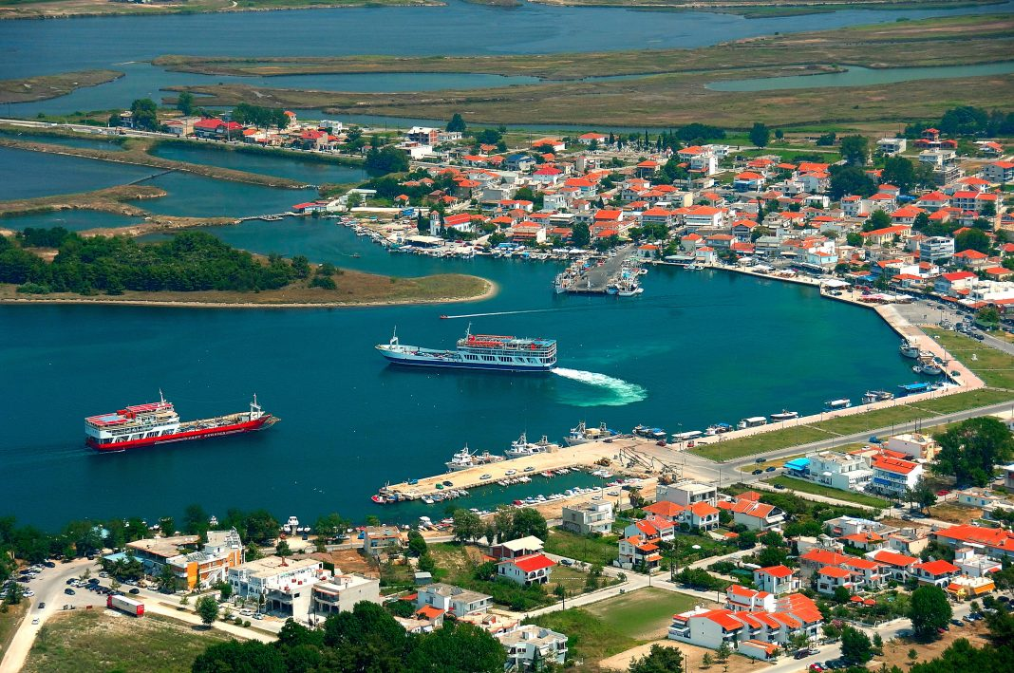
History of The Port of Keramoti.
In the Ancient times, the area around Keramoti has been inhabited for centuries. It was an important place during ancient times, but it was not as famous as some other Greek cities. People in the area depended on the sea for fishing and trade.
During the Roman Empire, Keramoti was part of the Roman territory. Like many coastal towns in the region, it played a role in trade, connecting various parts of the empire.
                In the Middle Ages, Keramoti was under the control of the Byzantine Empire. It was a peaceful, quiet area, not involved in major wars, but still important for local trade and fishing.
                After Greece gained independence from the Ottomans in the 19th century, Keramoti continued to be a small but important port. Today, it is mainly known for its ferry services to the nearby island of Thassos, as well as its beautiful beaches, attracting tourists and local visitors.
Today, Keramoti is a quiet but active town, with its port still playing an important role in transportation, trade, and tourism. The town has kept its charm, combining history with modern life.
During the Ottoman rule in the 15th century, Keramoti became part of the Ottoman Empire. The Ottomans controlled the region for several hundred years, and during this time, the port began to grow as a small, busy trading center.

Slide 16
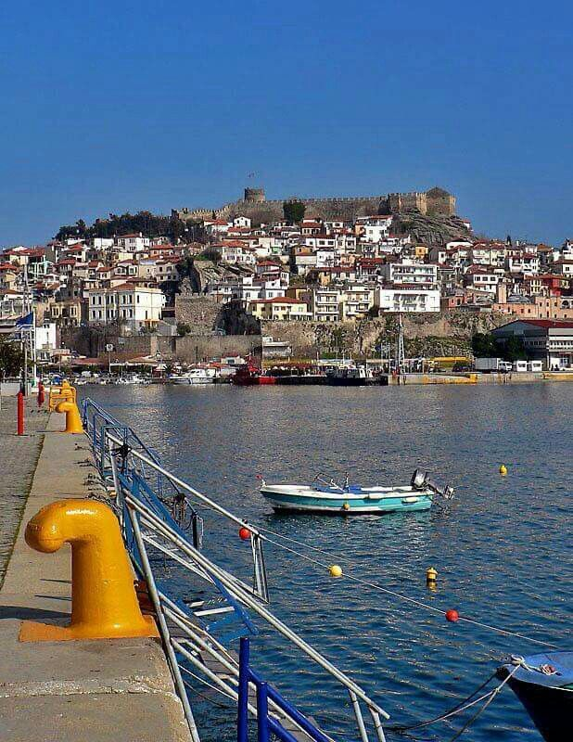
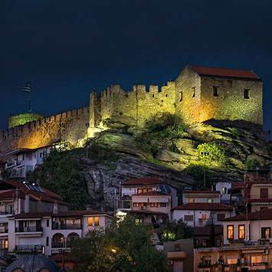
Things to do at Kavala.
Kavala is a beautiful coastal city in northern Greece, perfect for history lovers and beachgoers alike. Visit the Kavala Castle for stunning views, explore the Old Town (Panagia) with its charming streets, and admire the Kamares Aqueduct, an impressive Ottoman structure. Relax on beaches like Batis and Tosca, or take a short trip to the Philippi archaeological site, a UNESCO World Heritage spot. For a cultural touch, check out the Imaret, a historic Ottoman building, or the Tobacco Museum to learn about the city's past. Finally, enjoy fresh seafood at a seaside taverna or take a ferry to Thassos Island for a quick getaway.
Special foods that Kavala has.
Kavala has a few special foods you won’t find everywhere. Kavala Kourabiedes are buttery almond cookies, different from other Greek versions. Ladopita is a soft, sweet olive oil cake made only in the region. Stuffed mussels with rice and herbs are a local seafood favorite. And while Bougatsa is common in Greece, Kavala’s version is extra crispy and delicious. These unique flavors make the city’s food special!

Slide 17

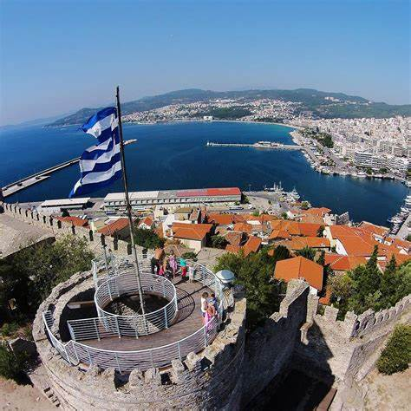
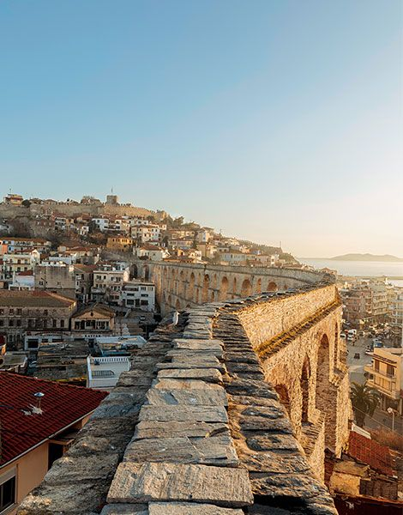
In conclusion, about Kavala.
Kavala is a perfect mix of history, culture, and seaside charm. With its stunning castle, charming old town, and beautiful beaches, it offers something for everyone. The city's rich past is reflected in its unique architecture, from the Ottoman-built aqueduct to the ancient ruins of Philippi nearby. Local flavors, like Kavala’s famous kourabiedes and fresh seafood, make the experience even more special. Whether you’re exploring historic sites, relaxing by the sea, or enjoying delicious food, Kavala leaves a lasting impression as one of Greece’s hidden gems.

Slide 18
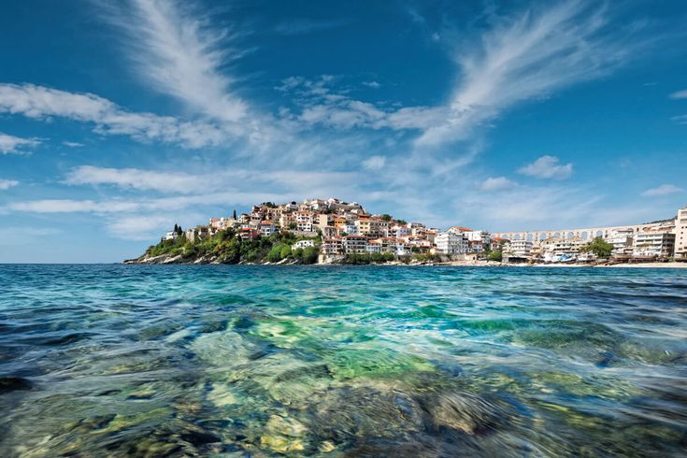
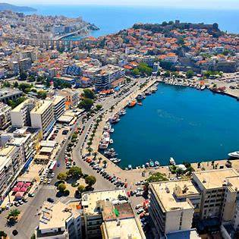
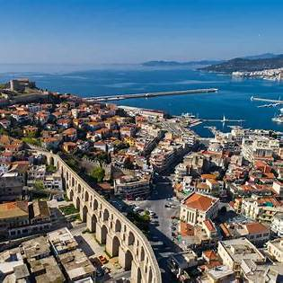
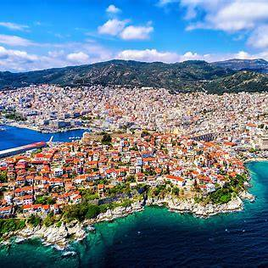
I sincerely appreciate you watching!
A project made by Elena Baltzoglou...

