Slide 1
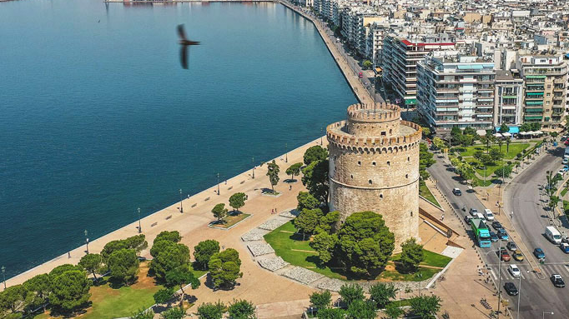
The port of Thessaloniki
Ioannis Kalafatis

Slide 2

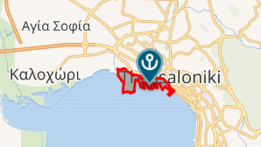
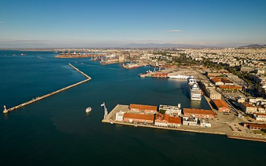
The port of Thessaloniki is one of the most important and busiest ports in Greece and the Balkans. Located in the northern part of the country, it serves as a major gateway for trade and transportation, connecting Europe with the Mediterranean and Asia. With a rich history dating back to ancient times, the port has played a crucial role in the city’s economic and cultural development. Today, it is a modern facility handling cargo, passenger ferries, and cruise ships, contributing significantly to Thessaloniki’s economy and international trade.

Slide 3
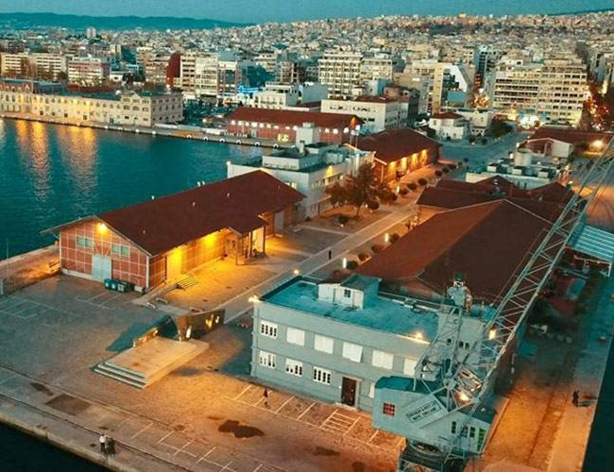
Historical Background
The port of Thessaloniki has been a vital hub of trade and culture for centuries. Established in ancient times, it flourished under the Roman and Byzantine Empires, serving as a key gateway between East and West. During the Ottoman period, it became one of the most important ports in the Balkans, facilitating commerce and migration. In the 20th century, the port played a crucial role in Greece’s economic development.

Slide 4
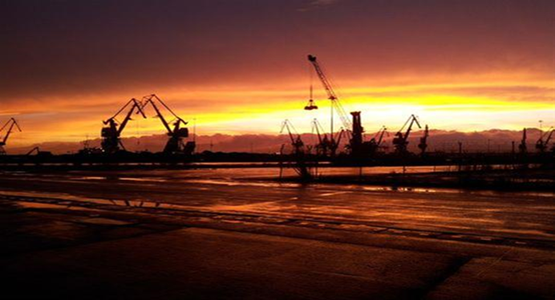
The importance of the port in the Economy
The port of Thessaloniki plays an important role in the economy of Greece and the wider Balkan region. As one of the largest and busiest ports in the country, it serves as a major gateway for trade, handling a significant volume of imports and exports. It supports various industries, including shipping, logistics, and manufacturing, while also creating thousands of jobs.
The port of Thessaloniki is strategically located in northern Greece, on the Aegean Sea, making it a key gateway between Europe, the Balkans, and the Eastern Mediterranean.

Slide 5
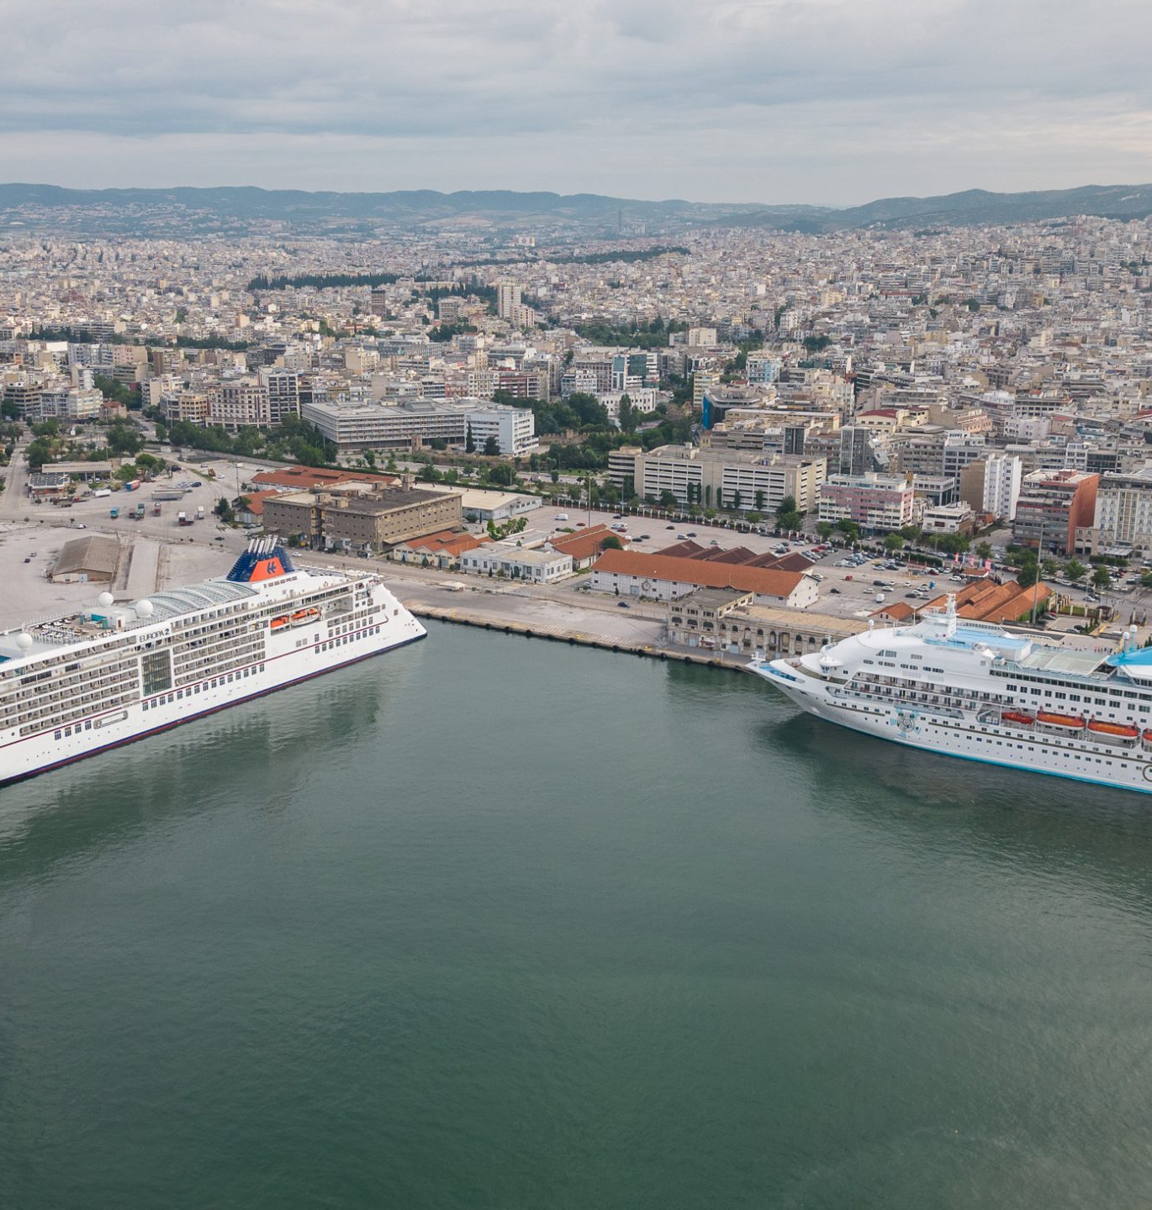
"Thessaloniki’s Port: The center of tourism
Its location near the historic city center makes it an ideal place for visitors exploring Thessaloniki’s cultural landmarks, vibrant markets, and lively waterfront. The port also connects Greece with popular island destinations such us Limnos, Thasos and Lesvos and neighboring countries, boosting regional tourism. Investments in modernizing passenger terminals and expanding cruise facilities have strengthened its position as a major tourist hub, attracting travelers from around the world and contributing to the local economy.

Slide 6
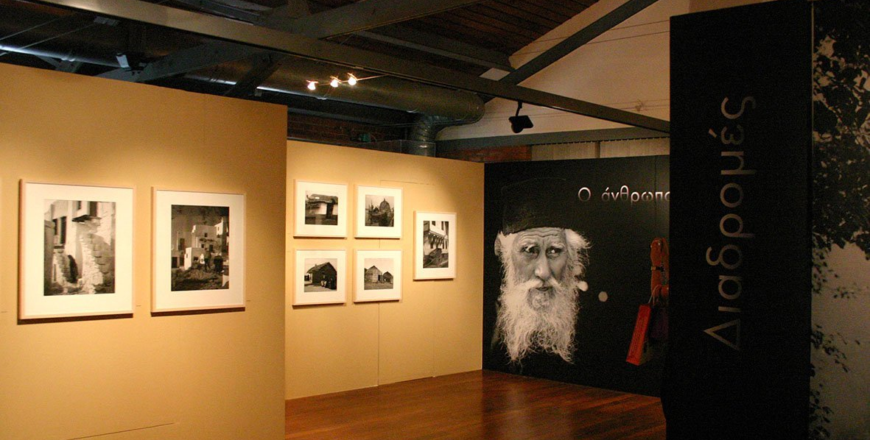
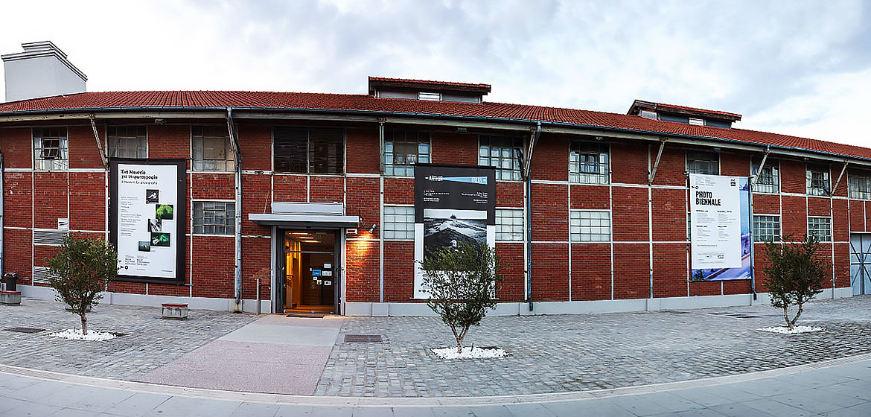
Museum of Photography
The Thessaloniki Museum of Photography, located at the city’s port, is a major cultural attraction dedicated to the art of photography. Housed in a historic warehouse, the museum showcases a rich collection of Greek and international photography, spanning different periods and styles. It hosts temporary exhibitions, photography festivals, and educational programs, attracting both art enthusiasts and professionals.

Slide 7





Thank you for your attention

