Slide 1

The Port and the city of Volos
2nd Junior High School of Evosmos Thessaloniki
"Ioannis Kakridis"
Student: Georgia Pelteki A'2 Teacher: Evgenia Tarenidou
Erasmus 2025

Slide 2
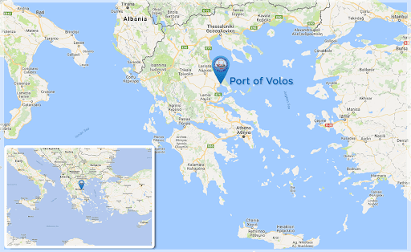
► Volos is a city situated at the centre of the Greek mainland, about 326 km north of Athens and 215 km south of Thessaloniki.
► It is the capital of the Magnesia Prefecture.
► With a population of around 83,000 it is an important industrial centre, while its port provides a bridge between Europe, the Middle East and Asia.

Slide 3
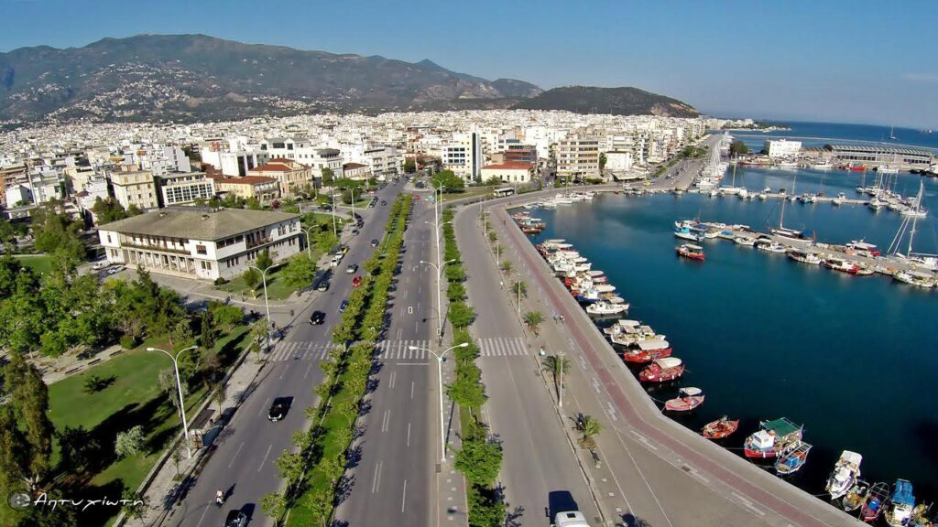
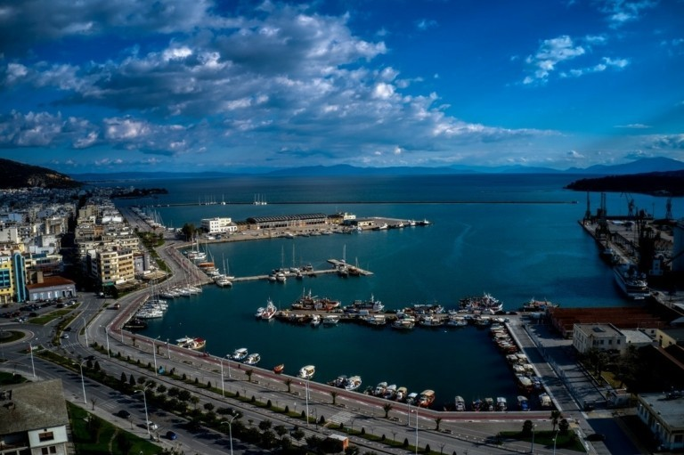
THE PORT OF VOLOS
Volos Port in its current location was founded in 1893 and today is the third largest cargo port in Greece behind Piraeus and Thessaloniki, moving agricultural and industrial products.
It is also a leading ferry port connecting to the nearby Sporades Islands, and an important cruise ship destination, with ships carrying well over 100,000 visitors every summer.
The port is operated by the Port Authority of Volos which was acquired in October 2023 by the Port of Thessaloniki.

Slide 4
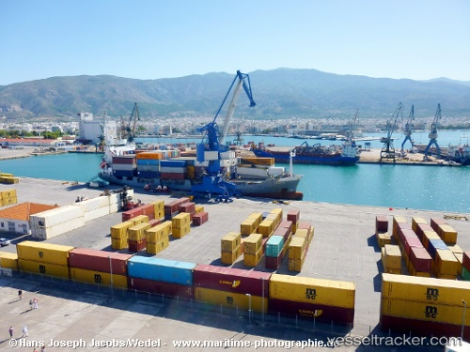
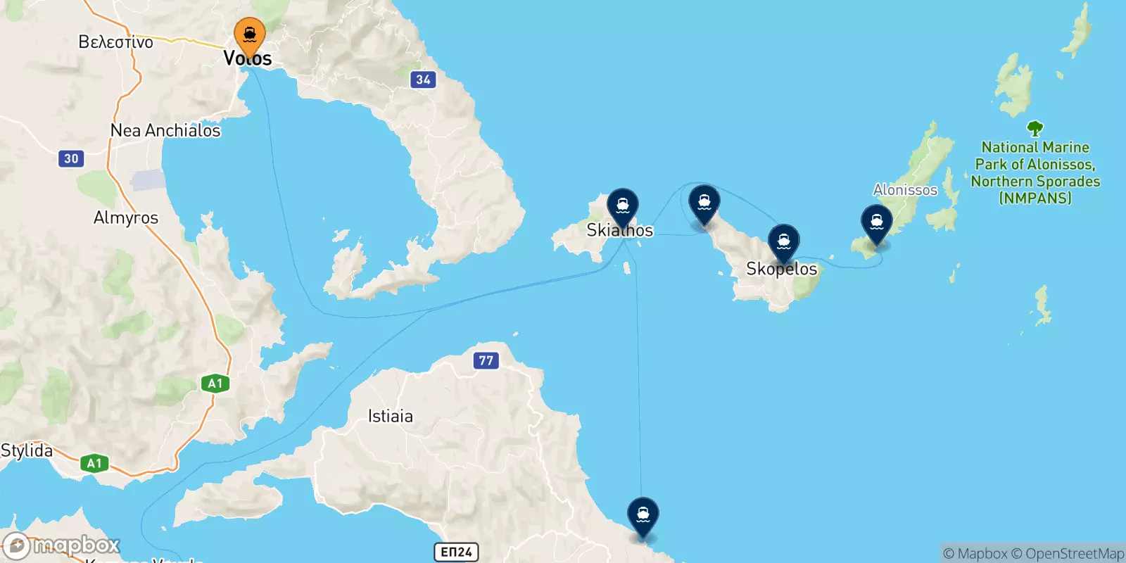
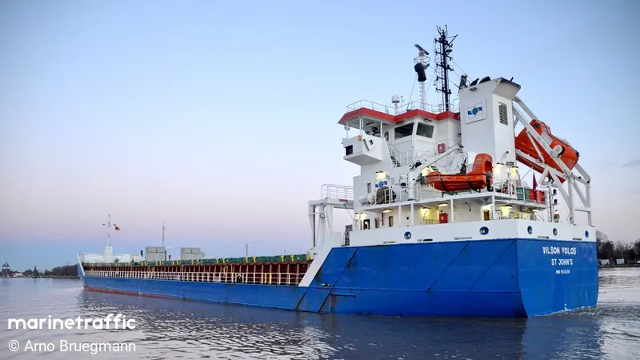
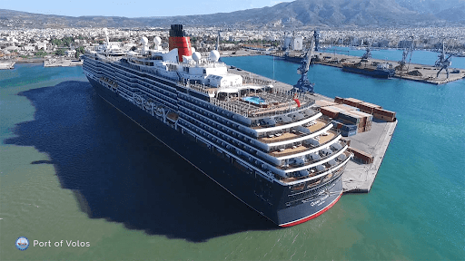
General Description of the Port
The port is handling cargoes (containers, dry bulk and general cargoes) and facilitates passenger traffic (cruise and coastal).
Volos is connected by ferries with the Sporades islands complex and occasionally with the North Aegean Sea islands.

Slide 5
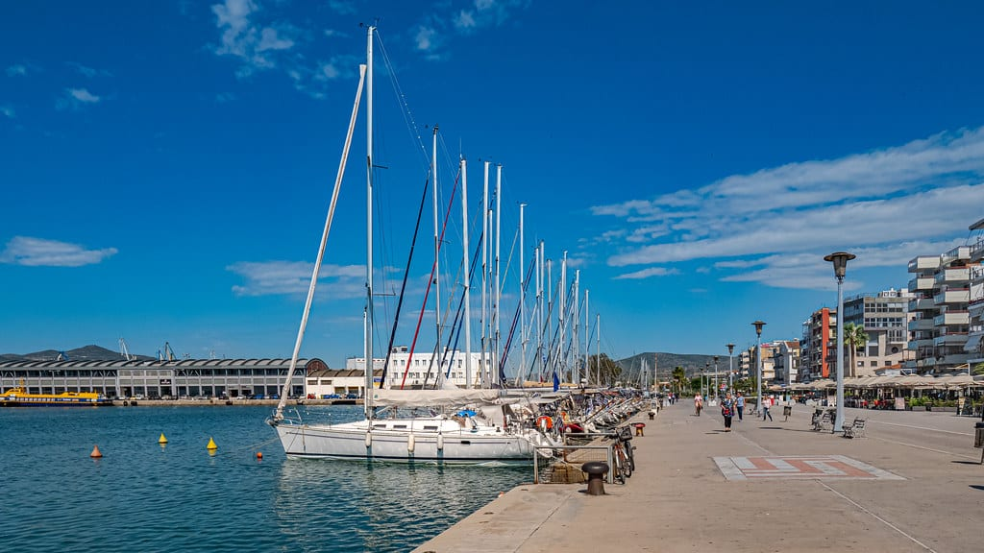
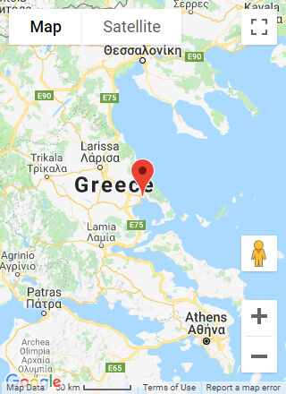

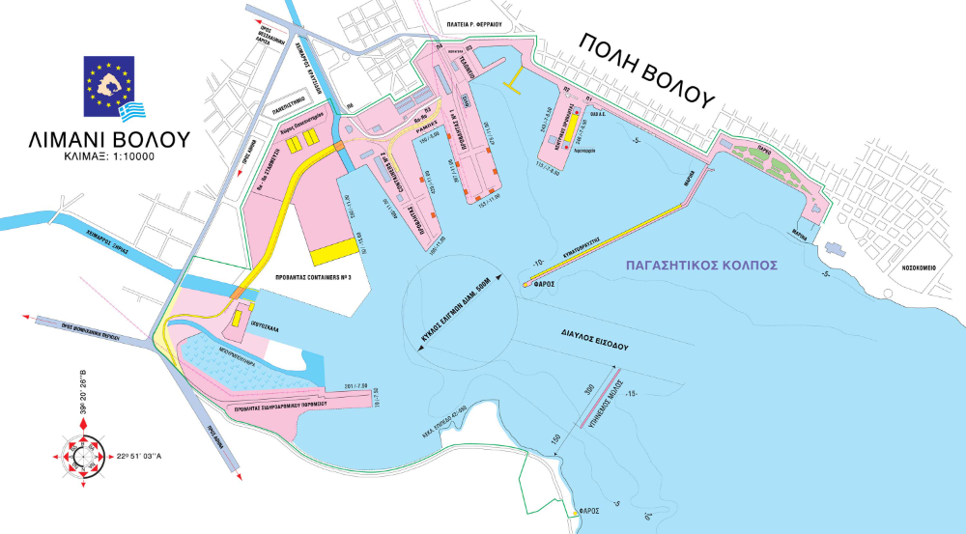
Moreover, it provides a marina close to the Main PIER 4 with a capacity of 170 yachts and sailing boats.
The port of Volos has a direct connection with major urban regions of Greece via the major motorway Patras-Athens-Thessaloniki. The port infrastructure includes five piers, with a total length of 3.195 meters and depth of up to 11 meters.

Slide 6
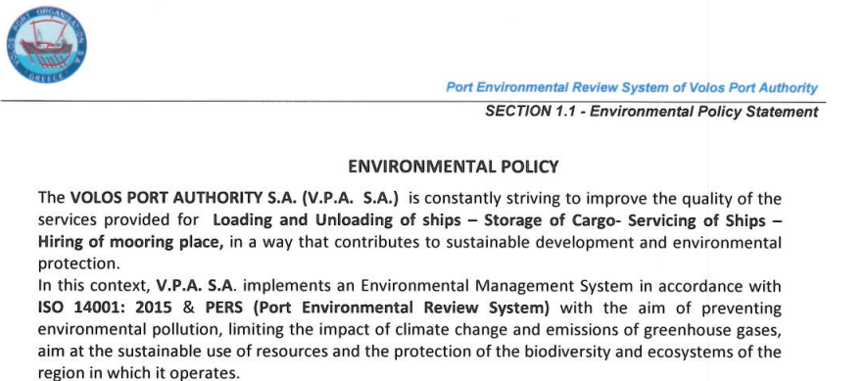
Environmental Policy

Slide 7
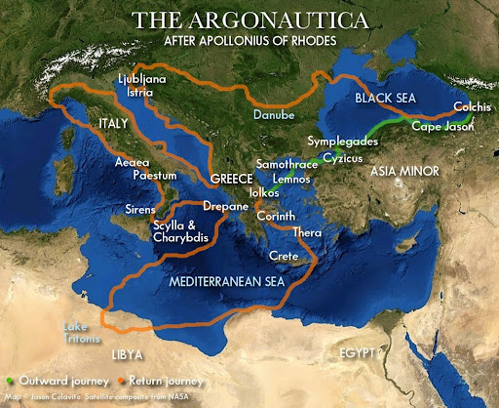
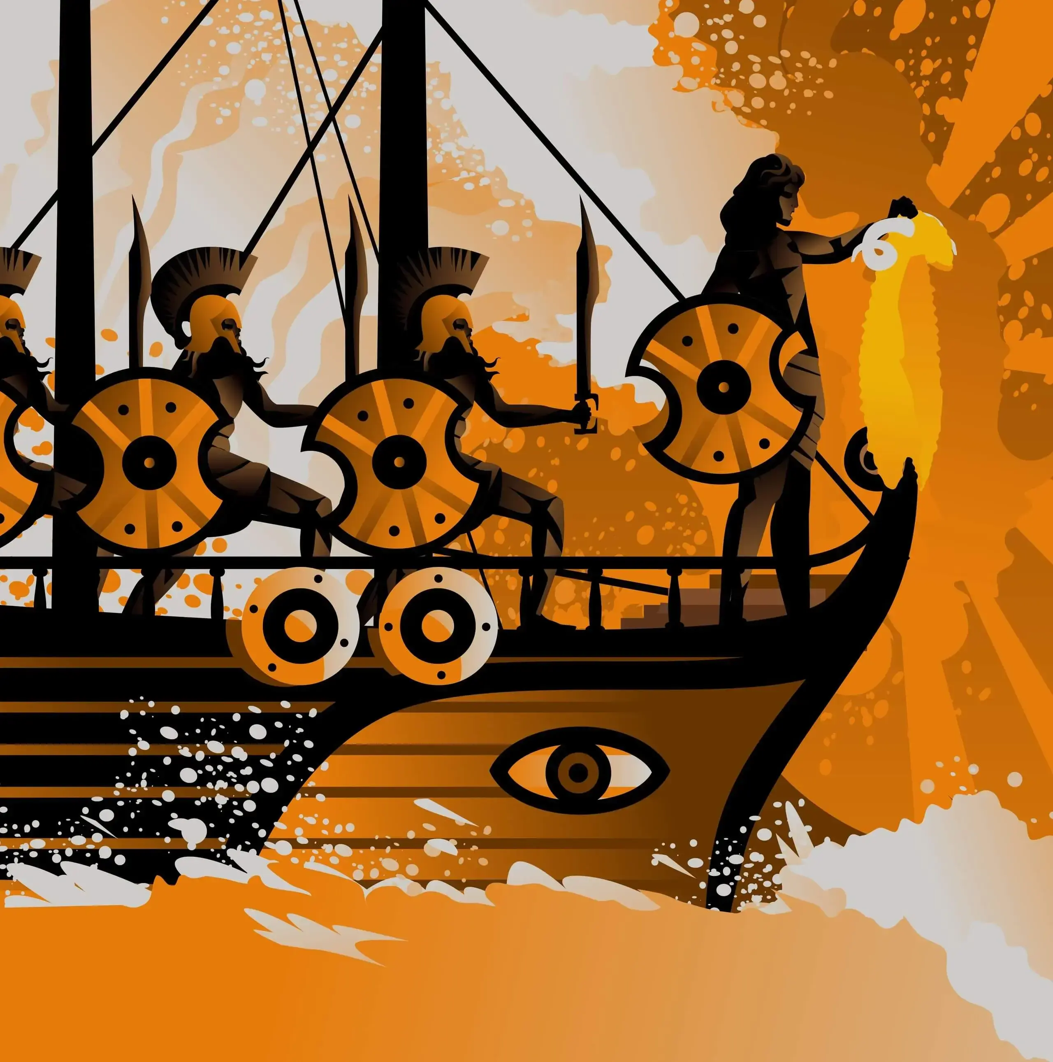
THE MYTH OF THE PORT
The myth of the Argonaut Expedition is a well-known legend. Jason and the Argonauts set out from ancient Iolkos in an Argo ship to reach ancient Colchis, take the Golden Fleece and bring it back to the region of Thessaly.
The myth is well known in both places where the story unfold, οne of which is in Volos, the contemporary land of Ancient Iolkos.
In Volos, a tomb monument was discovered in 2004, and so a precious treasure that was hidden for more than 3000 years. The treasure consisted of precious objects which owned to the king.
The legend is still alive in current excavations, in the museums collections, in the people minds, across the contemporary city of Volos.

Slide 8
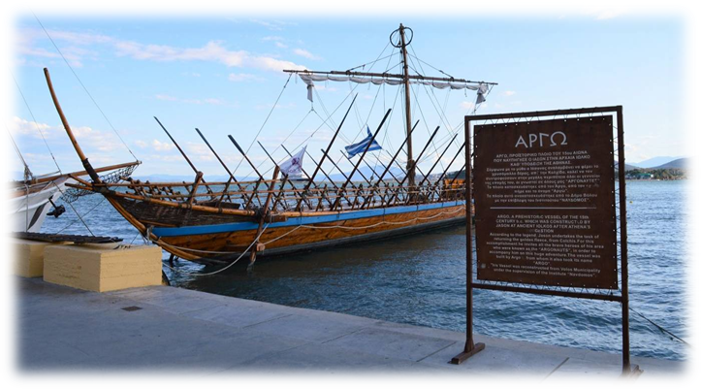
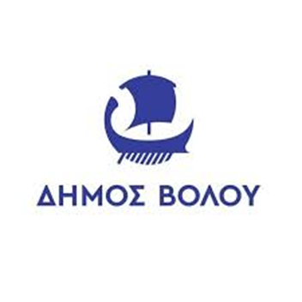
The names of the Argo crew is still written on the Argo statue at the front of Volos port.
There are many shops and restaurants named by the elements of the legend.
The symbol of the Municipality of Volos is this very same ship

Slide 9
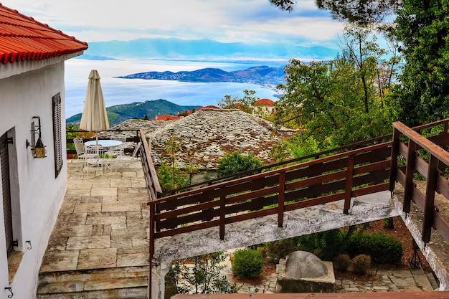
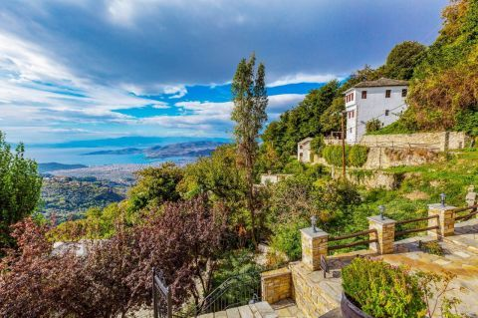
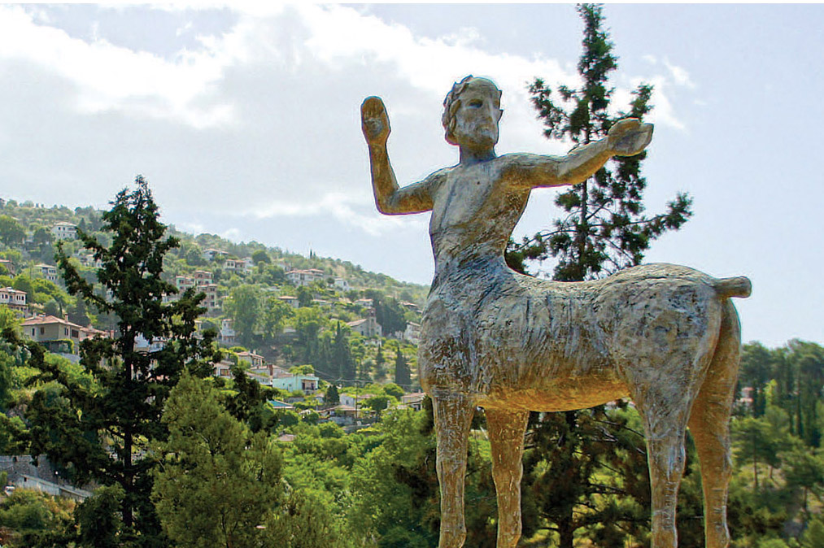
Mount Pelion – Land of the Centaurs
The Pelion peninsula consists of beautiful mountain villages and it is located above the city of Volos. The whole region is characterized by an astonishing mountain landscape and gorgeous sea views.
In Greek mythology, Mount Pelion (which took its name from the mythical king Peleus, father of Achilles) was the homeland of Chiron the Centaur, tutor of many ancient Greek heroes, such as Jason, Achilles, Theseus and Heracles.

Slide 10
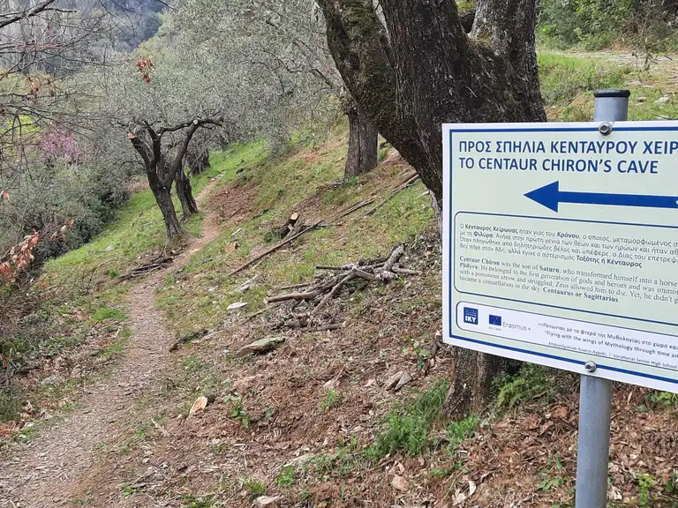
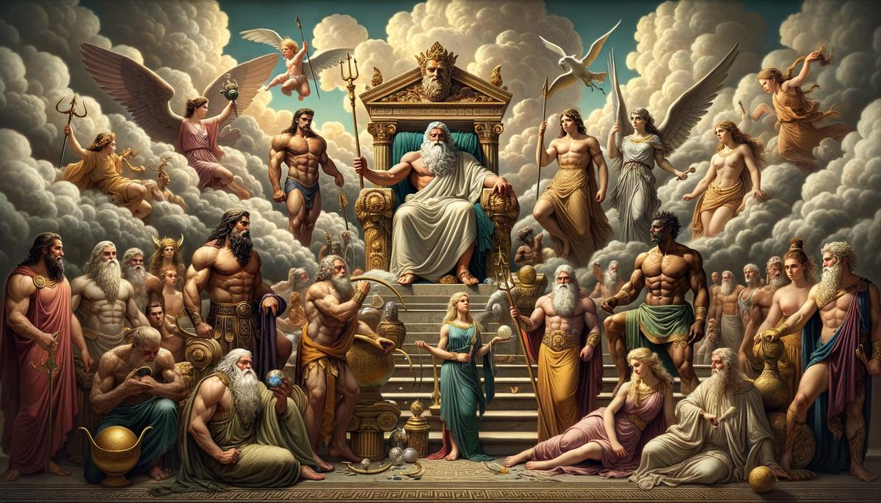
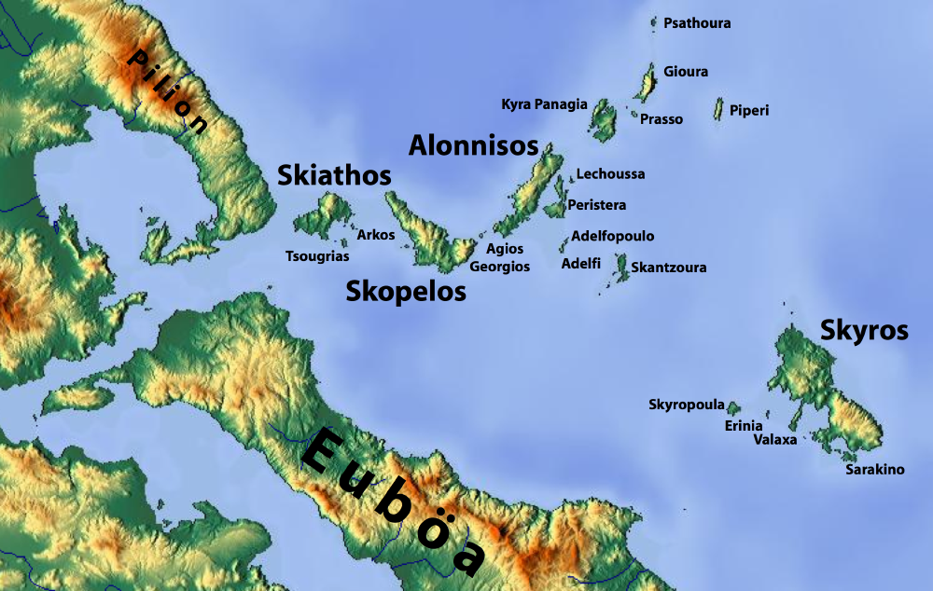
On Mount Pelion, near Chiron's cave, the marriage of Thetis and Peleus took place. The uninvited goddess Eris, to take revenge for having been kept outside the party, brought a golden apple with the inscription "To the Fairest". The dispute that then arose between the goddesses Hera, Aphrodite and Athena resulted in events leading to the Trojan War.
In addition, according to Greek mythology, Pelion was the summer retreat of the 12 Olympians. By throwing boulders from here and down into the sea, Zeus created the beautiful Sporades islands (Skiathos, Skopelos and Alonissos).

Slide 11
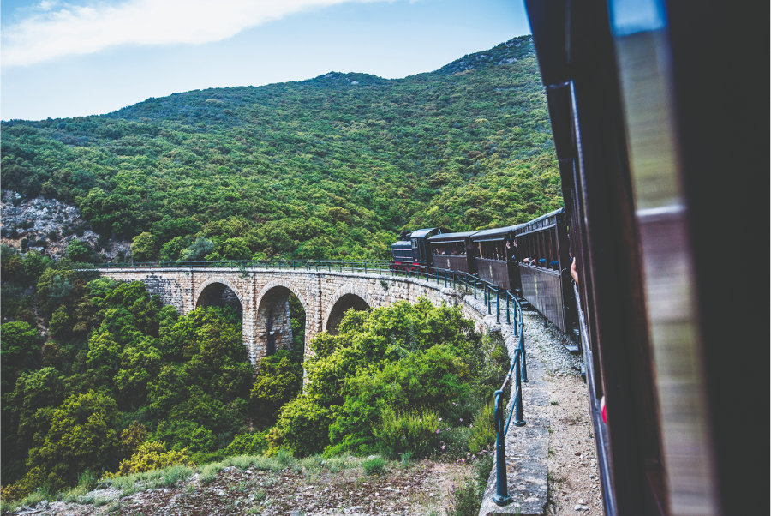
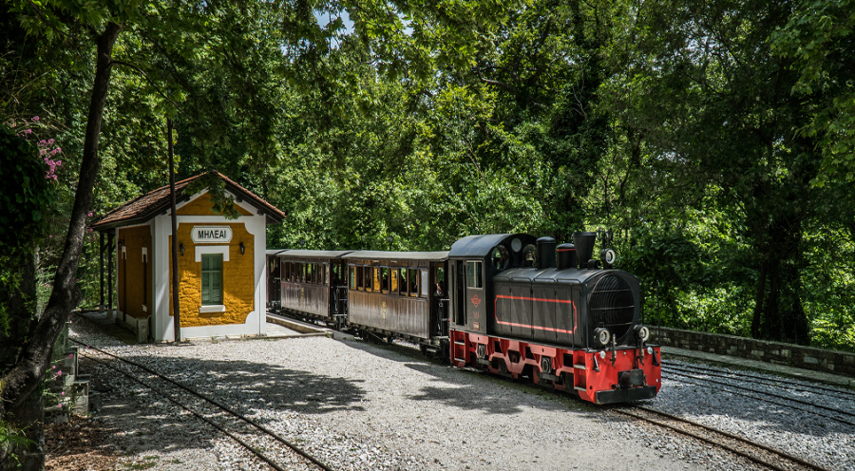
The Pelion train – a mythical route
Built in two stages, between 1892 and 1903, the railway route was an important factor in the further development of the villages of Pelion. Evaristo de Chirico, father of the famous painter Giorgio de Chirico, supervised the construction of the railway network. In the construction of the network, young De Chirico was there, observing the medium that would later inspire and consistently accompany his creation

Slide 12
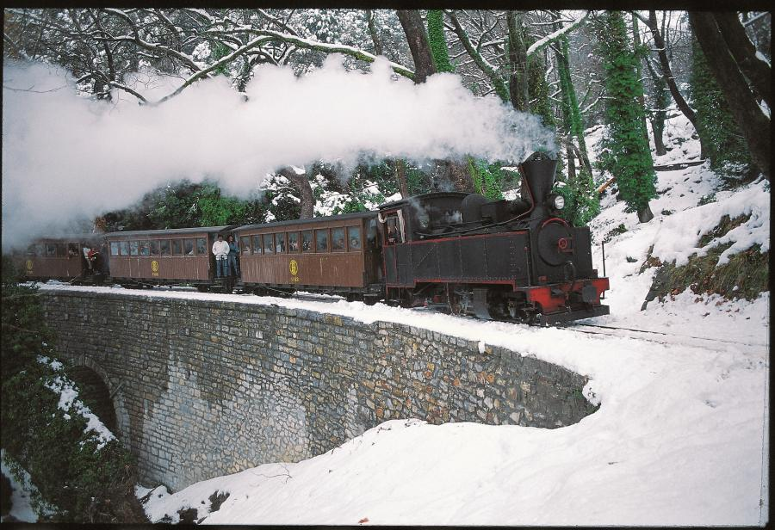
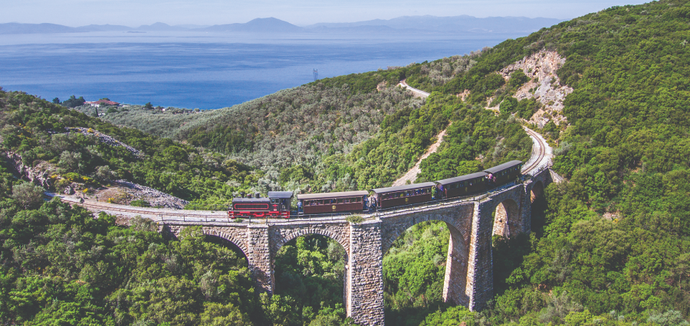
Mountzouris, as the Pelion Train as it was once called, because of the steam and the smoke it left in its passage by the steam engine, crosses a route of about 90 minutes journey and of a total length of 15 kilometers and a time of about 90 minutes.
The route includes images of magnificent natural landscape and intricate human constructions of carved marble and gray limestone, arched bridges, arches and gables of the tunnels.

Slide 13
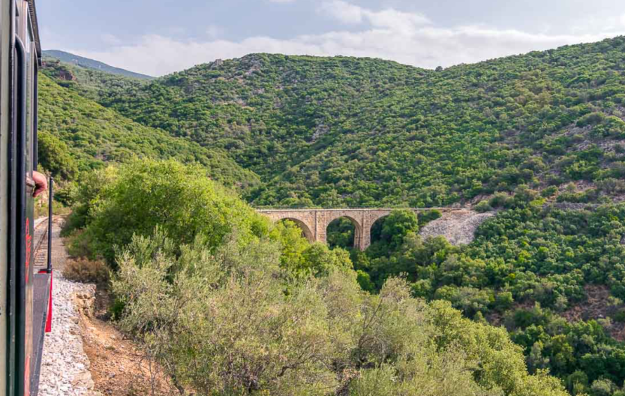
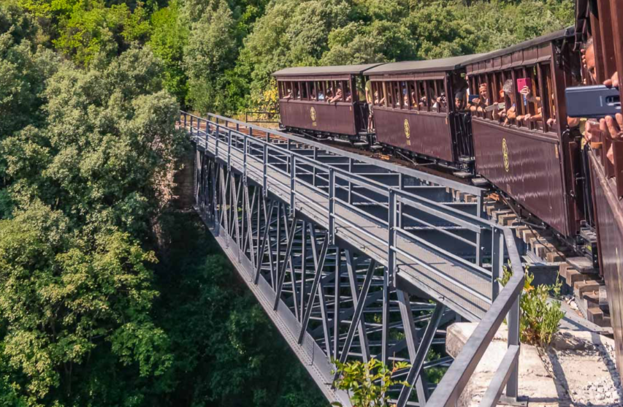
What to do in Volos!
The ultimate highlight of any trip to Volos and Pelion is the narrow gauge Pelion Train or trenaki (little train) as locals affectionately call it.
Apart from the exceptional natural scenery, riding the Pelion Train is also a unique way to marvel at architectural wonders along the way. The most striking of these are the five-arched stone bridge of Kalorema and the superb De Chirico Bridge.

Slide 14
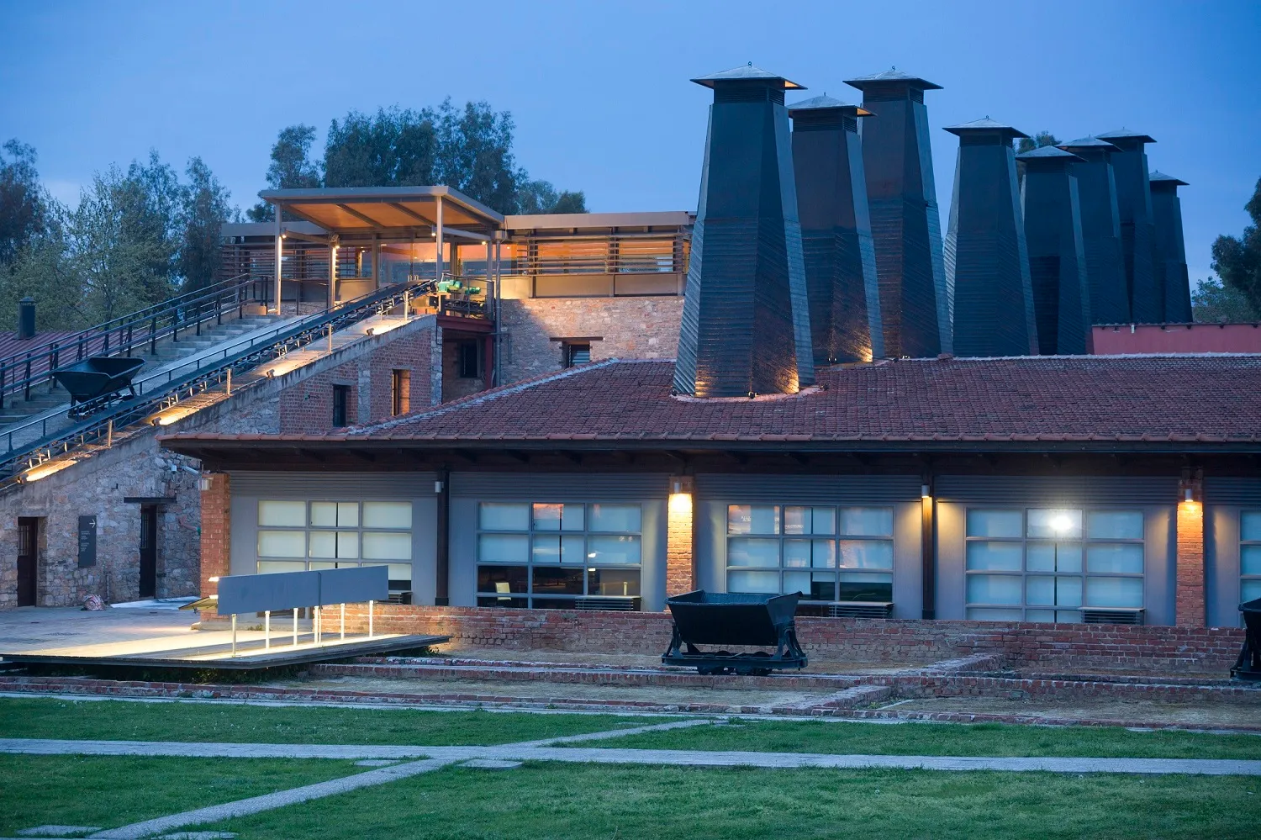
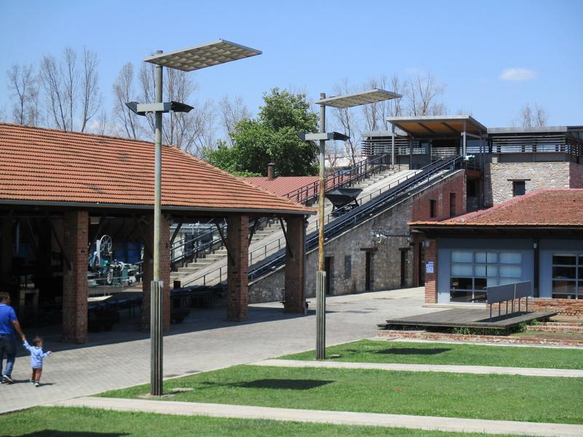
Visiting the Tsalapatas Rooftile and Brickworks Museum is one of the top things to do in Volos. Fascinating for children and adults alike, the Tsalapatas Museum is a rare example of a surviving industrial complex in Greece. The museum is housed in a former rooftile and brickworks factory and it aims to showcase the industrial heritage of the city of Volos.

Slide 15
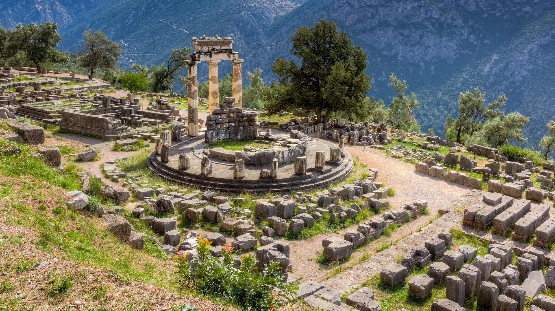
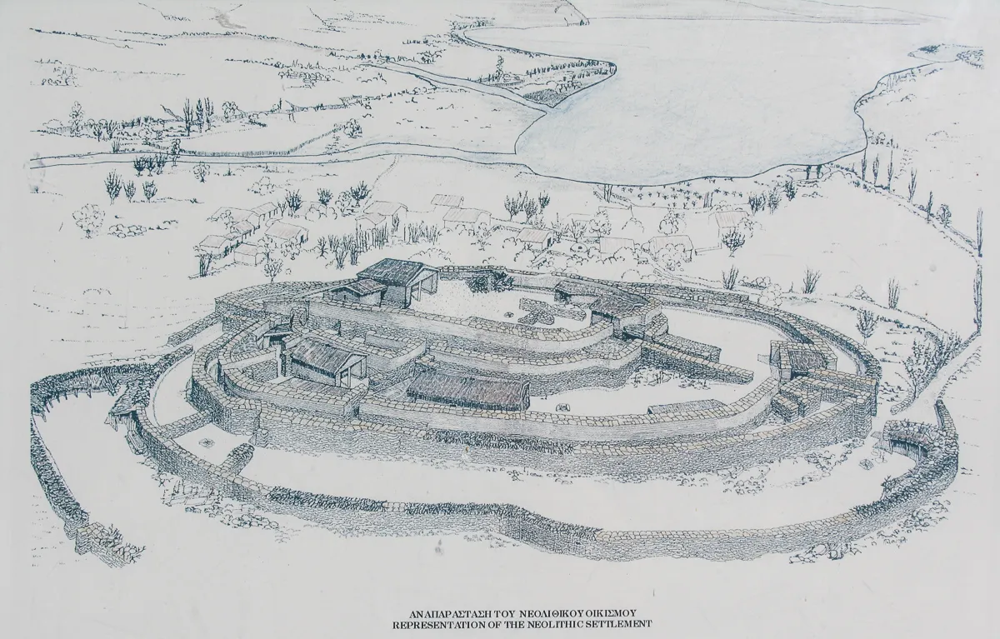
See an Ancient Civilization at the Archaeological Site of Dimini. Three miles outside of Volos, the Dimini site provides us with one of the most complete pictures of a Neolithic settlement available. This well-organized, 25-acre Neolithic settlement has ruins going back to the 5th Century B.C. and is believed to have been home to a thriving and sophisticated stone age community with a rich social culture.

Slide 16
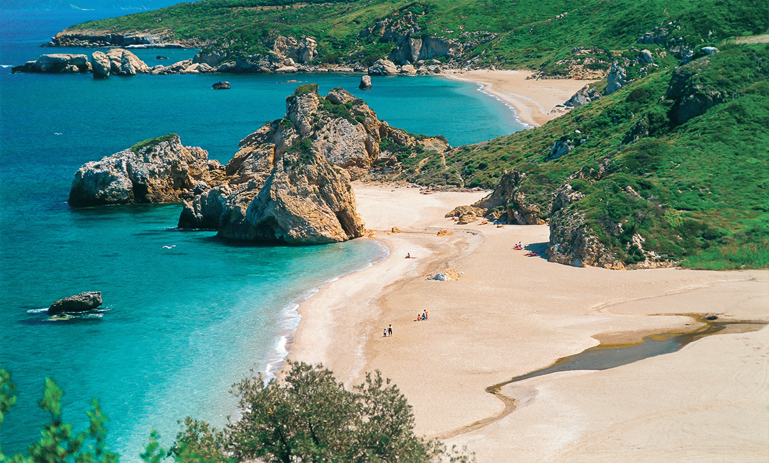
Relax on the Beach!
Volos has some of the best beaches in Greece. Alykes is a popular choice for central Volos with sunbeds, watersports, bars, tavernas, and other amenities along the sandy shores. If you want to explore the surrounding areas, Anchialos Beach and Pigadia Beach are just two of the many options you’ll find.

Slide 17
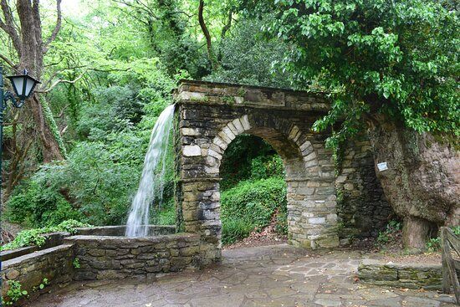
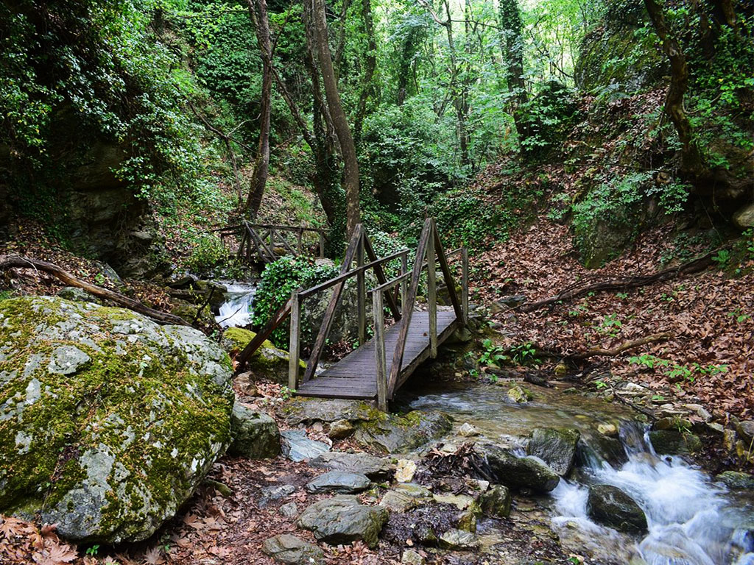
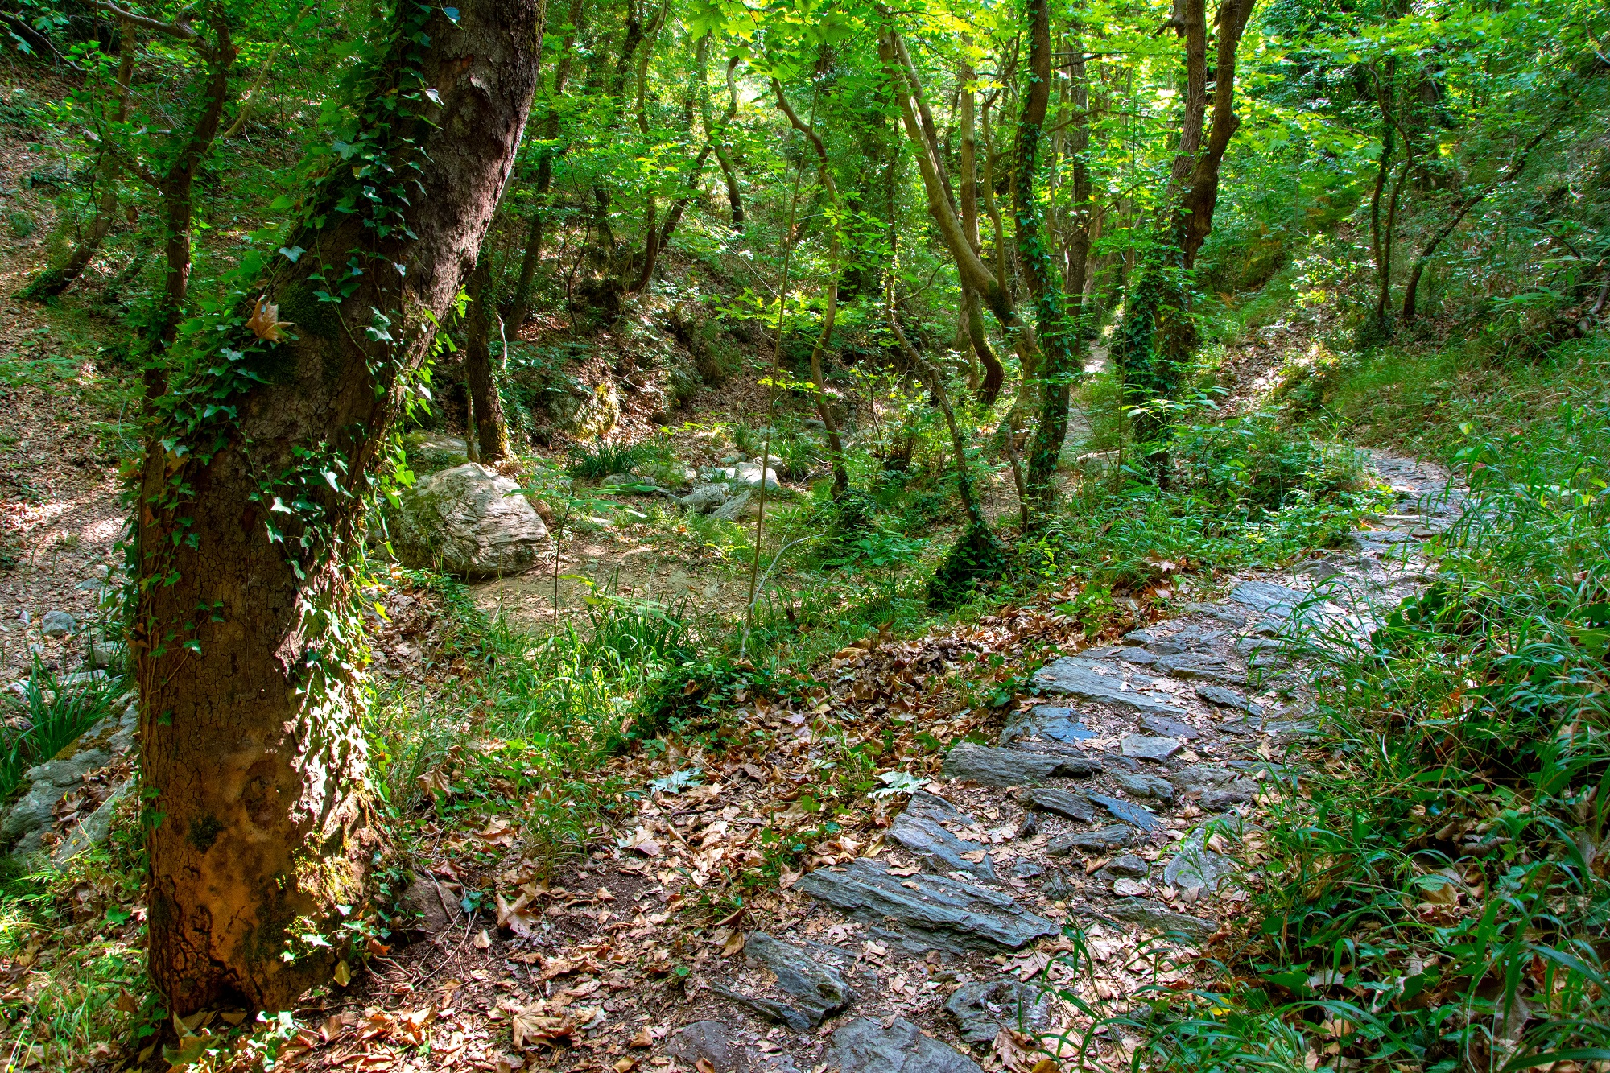
Walk the Centaur’s Path in Portaria.
The Centaur’s Path is a short hiking path in Portaria village located about 6 miles from Volos. The gentle trail is less than a mile long, taking about 40 minutes to complete, and offers you another magical window into the natural beauty of the area. According to Greek mythology, Volos and the surrounding area was home to the centaurs, half-human half-horse creatures with mystical powers. The Centaur’s Path is marked with red circles on stones making it easy to follow.

Slide 18

Thank you
for
your attention!

